Slide 1
Sorting
Chapter 10

Slide 2
Chapter Objectives
To learn how to use the standard sorting functions in algorithm.h
To learn how to implement the following sorting algorithms:
selection sort
bubble sort
insertion sort
Shell sort
merge sort
heapsort
quicksort
To understand the difference in performance of these algorithms, and which to use for small, medium, and large arrays

Slide 3
Introduction
Sorting entails arranging data in decreasing (or nonincreasing) or increasing (or nondecreasing) order
Familiarity with sorting algorithms is an important programming skill
The study of sorting algorithms provides insight into
problem solving techniques such as divide and conquer
the analysis and comparison of algorithms which perform the same task

Slide 4
Using C++ Sorting Methods
The Standard C++ Library (in algorithm.h) provides two sorting functions
Each function uses a pair of random-access iterators (typename RI):
template<typename RI>
void sort(RI first, RI last);
template<typename RI, typename Compare>
void sort(RI first, RI last, Compare comp);

Slide 5
Using C++ Sorting Methods (cont.)
Each function uses a pair of random access iterators (typename RI)
The first iterator references the first element of the sequence to be sorted
The second iterator references one past the last element in the sequence

Slide 6
Using C++ Sorting Methods (cont.)
Because these functions require random-access iterators, they can be used only with vectors, deques, and ordinary C pointers (for sorting arrays)
The list container supports only bidirectional iterators, so it provides its own sort member function

Slide 7
Using C++ Sorting Methods (cont.)
There are also two functions named stable_sort, which are similar to the sort functions
The primary difference is that elements that are equal may not retain their relative ordering when sort is used, but they will retain their relative ordering when stable_sort is used
In other words, if there are two occurrences of an item, the one that is first in the unsorted array is guaranteed to be first in the sorted array only if stable_sort is used
The sort function is slightly faster than stable_sort, so it should be used whenever the relative ordering of equal elements is unimportant

Slide 8
Using C++ Sorting Methods (cont.)
The actual type of random-access iterator passed to function sort depends on whether we are sorting an array, vector, or deque
The compiler attempts to match the actual types of the arguments to the template parameters
If we use the second version of function sort, we must also pass an object that implements a comparison function

Slide 9
Using C++ Sorting Methods (cont.)
If array items stores a collection of 16 integers, the statement
sort(items, items + 16);
sorts the array
The statement
sort(items, items + 8);
sorts only the first half of the array, leaving the rest untouched
The function call
sort(items, items + 16, greater<int>());
sorts the array in descending order using function greater<int>, which implements the comparison operator > for integers (defined in library functional)

Slide 10
Using C++ Sorting Methods (cont.)
The following statements sort the elements of vector v and deque d
sort(v.begin(), v.end());
sort(d.begin(), d.end());
The following statement shows how to sort the elements in vector v in descending order by using the comparison function greater<int>()
sort(v.begin(), v.end(), greater<int>());

Slide 11
Using C++ Sorting Methods (cont.)
In Section 9.2, we wrote the following Compare_Person function class:
struct Compare_Person {
bool operator()(const Person& p1, const Person& p2) {
return (p1.family_name < p2.family_name)
|| (p1.family_name == p2.family_name)
&& (p1.given_name < p2.given_name);
}
If people_list is a vector of Person objects, the statement
sort(people_list.begin(), people_list.end(), Compare_Person());
sorts the elements in people_list in ascending order based on their names
The client program must include header file "People.h", which defines class Person and struct Compare_Person

Slide 12
Selection Sort
Section 10.2

Slide 13
Selection Sort
Selection sort is relatively easy to understand
It sorts an array by making several passes through the array, selecting a next smallest item in the array each time and placing it where it belongs in the array
For simplicity, we illustrate all the sorting algorithms using an array of integer values

Slide 14
Trace of Selection Sort
n = number of elements in the array
for fill = 0 to n – 2 do
Set pos_min to the subscript of a smallest item in the subarray starting at subscript fill
Exchange the item at pos_min with the one at fill
0
1
2
3
4
35
65
30
60
20
n | 5
fill
pos_min

Slide 15
Trace of Selection Sort (cont.)
n = number of elements in the array
for fill = 0 to n – 2 do
Set pos_min to the subscript of a smallest item in the subarray starting at subscript fill
Exchange the item at pos_min with the one at fill
0
1
2
3
4
35
65
30
60
20
n | 5
fill | 0
pos_min
fill

Slide 16
Trace of Selection Sort (cont.)
n = number of elements in the array
for fill = 0 to n – 2 do
Set pos_min to the subscript of a smallest item in the subarray starting at subscript fill
Exchange the item at pos_min with the one at fill
0
1
2
3
4
35
65
30
60
20
n | 5
fill | 0
pos_min | 4
fill
pos_min

Slide 17
Trace of Selection Sort (cont.)
n = number of elements in the array
for fill = 0 to n – 2 do
Set pos_min to the subscript of a smallest item in the subarray starting at subscript fill
Exchange the item at pos_min with the one at fill
0
1
2
3
4
20
65
30
60
35
n | 5
fill | 0
pos_min | 4
fill
pos_min

Slide 18
Trace of Selection Sort (cont.)
n = number of elements in the array
for fill = 0 to n – 2 do
Set pos_min to the subscript of a smallest item in the subarray starting at subscript fill
Exchange the item at pos_min with the one at fill
0
1
2
3
4
20
65
30
60
35
n | 5
fill | 1
pos_min | 4
fill
pos_min

Slide 19
Trace of Selection Sort (cont.)
n = number of elements in the array
for fill = 0 to n – 2 do
Set pos_min to the subscript of a smallest item in the subarray starting at subscript fill
Exchange the item at pos_min with the one at fill
0
1
2
3
4
20
65
30
60
35
n | 5
fill | 1
pos_min | 2
fill
pos_min

Slide 20
Trace of Selection Sort (cont.)
n = number of elements in the array
for fill = 0 to n – 2 do
Set pos_min to the subscript of a smallest item in the subarray starting at subscript fill
Exchange the item at pos_min with the one at fill
0
1
2
3
4
20
30
65
60
35
n | 5
fill | 1
pos_min | 2
fill
pos_min

Slide 21
Trace of Selection Sort (cont.)
n = number of elements in the array
for fill = 0 to n – 2 do
Set pos_min to the subscript of a smallest item in the subarray starting at subscript fill
Exchange the item at pos_min with the one at fill
0
1
2
3
4
20
30
65
60
35
n | 5
fill | 2
pos_min | 2
fill
pos_min

Slide 22
Trace of Selection Sort (cont.)
n = number of elements in the array
for fill = 0 to n – 2 do
Set pos_min to the subscript of a smallest item in the subarray starting at subscript fill
Exchange the item at pos_min with the one at fill
0
1
2
3
4
20
30
65
60
35
n | 5
fill | 2
pos_min | 4
fill
pos_min

Slide 23
Trace of Selection Sort (cont.)
n = number of elements in the array
for fill = 0 to n – 2 do
Set pos_min to the subscript of a smallest item in the subarray starting at subscript fill
Exchange the item at pos_min with the one at fill
0
1
2
3
4
20
30
35
60
65
n | 5
fill | 2
pos_min | 4
fill
pos_min

Slide 24
Trace of Selection Sort (cont.)
n = number of elements in the array
for fill = 0 to n – 2 do
Set pos_min to the subscript of a smallest item in the subarray starting at subscript fill
Exchange the item at pos_min with the one at fill
0
1
2
3
4
20
30
35
60
65
n | 5
fill | 3
pos_min | 4
fill
pos_min

Slide 25
Trace of Selection Sort (cont.)
n = number of elements in the array
for fill = 0 to n – 2 do
Set pos_min to the subscript of a smallest item in the subarray starting at subscript fill
Exchange the item at pos_min with the one at fill
0
1
2
3
4
20
30
35
60
65
n | 5
fill | 3
pos_min | 3
fill
pos_min

Slide 26
Trace of Selection Sort (cont.)
n = number of elements in the array
for fill = 0 to n – 2 do
Set pos_min to the subscript of a smallest item in the subarray starting at subscript fill
Exchange the item at pos_min with the one at fill
0
1
2
3
4
20
30
35
60
65
n | 5
fill | 3
pos_min | 3
fill
pos_min

Slide 27
Trace of Selection Sort (cont.)
n = number of elements in the array
for fill = 0 to n – 2 do
Set pos_min to the subscript of a smallest item in the subarray starting at subscript fill
Exchange the item at pos_min with the one at fill
0
1
2
3
4
20
30
35
60
65
n | 5
fill | 3
pos_min | 3

Slide 28
Trace of Selection Sort Refinement
n | 5
fill
pos_min
next
for fill = 0 to n – 2 do
Initialize pos_min to fill
for next = fill + 1 to n – 1 do
if the item at next is less than the item at pos_min
Reset pos_min to next
Exchange the item at pos_min with the one at fill
0
1
2
3
4
35
65
30
60
20

Slide 29
Trace of Selection Sort Refinement (cont.)
n | 5
fill | 0
pos_min
next
for fill = 0 to n – 2 do
Initialize pos_min to fill
for next = fill + 1 to n – 1 do
if the item at next is less than the item at pos_min
Reset pos_min to next
Exchange the item at pos_min with the one at fill
0
1
2
3
4
35
65
30
60
20
fill

Slide 30
Trace of Selection Sort Refinement (cont.)
n | 5
fill | 0
pos_min | 0
next
for fill = 0 to n – 2 do
Initialize pos_min to fill
for next = fill + 1 to n – 1 do
if the item at next is less than the item at pos_min
Reset pos_min to next
Exchange the item at pos_min with the one at fill
0
1
2
3
4
35
65
30
60
20
fill
pos_min

Slide 31
Trace of Selection Sort Refinement (cont.)
n | 5
fill | 0
pos_min | 0
next | 1
for fill = 0 to n – 2 do
Initialize pos_min to fill
for next = fill + 1 to n – 1 do
if the item at next is less than the item at pos_min
Reset pos_min to next
Exchange the item at pos_min with the one at fill
0
1
2
3
4
35
65
30
60
20
fill
next
pos_min

Slide 32
Trace of Selection Sort Refinement (cont.)
n | 5
fill | 0
pos_min | 0
next | 1
for fill = 0 to n – 2 do
Initialize pos_min to fill
for next = fill + 1 to n – 1 do
if the item at next is less than the item at pos_min
Reset pos_min to next
Exchange the item at pos_min with the one at fill
0
1
2
3
4
35
65
30
60
20
fill
next
pos_min

Slide 33
Trace of Selection Sort Refinement (cont.)
n | 5
fill | 0
pos_min | 0
next | 2
for fill = 0 to n – 2 do
Initialize pos_min to fill
for next = fill + 1 to n – 1 do
if the item at next is less than the item at pos_min
Reset pos_min to next
Exchange the item at pos_min with the one at fill
0
1
2
3
4
35
65
30
60
20
fill
next
pos_min

Slide 34
Trace of Selection Sort Refinement (cont.)
n | 5
fill | 0
pos_min | 0
next | 2
for fill = 0 to n – 2 do
Initialize pos_min to fill
for next = fill + 1 to n – 1 do
if the item at next is less than the item at pos_min
Reset pos_min to next
Exchange the item at pos_min with the one at fill
0
1
2
3
4
35
65
30
60
20
fill
next
pos_min

Slide 35
Trace of Selection Sort Refinement (cont.)
n | 5
fill | 0
pos_min | 2
next | 2
for fill = 0 to n – 2 do
Initialize pos_min to fill
for next = fill + 1 to n – 1 do
if the item at next is less than the item at pos_min
Reset pos_min to next
Exchange the item at pos_min with the one at fill
0
1
2
3
4
35
65
30
60
20
fill
next
pos_min

Slide 36
Trace of Selection Sort Refinement (cont.)
n | 5
fill | 0
pos_min | 2
next | 3
for fill = 0 to n – 2 do
Initialize pos_min to fill
for next = fill + 1 to n – 1 do
if the item at next is less than the item at pos_min
Reset pos_min to next
Exchange the item at pos_min with the one at fill
0
1
2
3
4
35
65
30
60
20
fill
next
pos_min

Slide 37
Trace of Selection Sort Refinement (cont.)
n | 5
fill | 0
pos_min | 2
next | 3
for fill = 0 to n – 2 do
Initialize pos_min to fill
for next = fill + 1 to n – 1 do
if the item at next is less than the item at pos_min
Reset pos_min to next
Exchange the item at pos_min with the one at fill
0
1
2
3
4
35
65
30
60
20
fill
next
pos_min

Slide 38
Trace of Selection Sort Refinement (cont.)
n | 5
fill | 0
pos_min | 2
next | 4
for fill = 0 to n – 2 do
Initialize pos_min to fill
for next = fill + 1 to n – 1 do
if the item at next is less than the item at pos_min
Reset pos_min to next
Exchange the item at pos_min with the one at fill
0
1
2
3
4
35
65
30
60
20
fill
next
pos_min

Slide 39
Trace of Selection Sort Refinement (cont.)
n | 5
fill | 0
pos_min | 2
next | 4
for fill = 0 to n – 2 do
Initialize pos_min to fill
for next = fill + 1 to n – 1 do
if the item at next is less than the item at pos_min
Reset pos_min to next
Exchange the item at pos_min with the one at fill
0
1
2
3
4
35
65
30
60
20
fill
next
pos_min

Slide 40
Trace of Selection Sort Refinement (cont.)
n | 5
fill | 0
pos_min | 4
next | 4
for fill = 0 to n – 2 do
Initialize pos_min to fill
for next = fill + 1 to n – 1 do
if the item at next is less than the item at pos_min
Reset pos_min to next
Exchange the item at pos_min with the one at fill
0
1
2
3
4
35
65
30
60
20
fill
next
pos_min

Slide 41
Trace of Selection Sort Refinement (cont.)
n | 5
fill | 0
pos_min | 4
next | 4
for fill = 0 to n – 2 do
Initialize pos_min to fill
for next = fill + 1 to n – 1 do
if the item at next is less than the item at pos_min
Reset pos_min to next
Exchange the item at pos_min with the one at fill
0
1
2
3
4
20
65
30
60
35
fill
next
pos_min

Slide 42
Trace of Selection Sort Refinement (cont.)
n | 5
fill | 1
pos_min | 4
next | 4
for fill = 0 to n – 2 do
Initialize pos_min to fill
for next = fill + 1 to n – 1 do
if the item at next is less than the item at pos_min
Reset pos_min to next
Exchange the item at pos_min with the one at fill
0
1
2
3
4
20
65
30
60
35
fill
next
pos_min

Slide 43
Trace of Selection Sort Refinement (cont.)
n | 5
fill | 1
pos_min | 1
next | 4
for fill = 0 to n – 2 do
Initialize pos_min to fill
for next = fill + 1 to n – 1 do
if the item at next is less than the item at pos_min
Reset pos_min to next
Exchange the item at pos_min with the one at fill
0
1
2
3
4
20
65
30
60
35
fill
next
pos_min

Slide 44
Trace of Selection Sort Refinement (cont.)
n | 5
fill | 1
pos_min | 1
next | 2
for fill = 0 to n – 2 do
Initialize pos_min to fill
for next = fill + 1 to n – 1 do
if the item at next is less than the item at pos_min
Reset pos_min to next
Exchange the item at pos_min with the one at fill
0
1
2
3
4
20
65
30
60
35
fill
next
pos_min

Slide 45
Trace of Selection Sort Refinement (cont.)
n | 5
fill | 1
pos_min | 1
next | 2
for fill = 0 to n – 2 do
Initialize pos_min to fill
for next = fill + 1 to n – 1 do
if the item at next is less than the item at pos_min
Reset pos_min to next
Exchange the item at pos_min with the one at fill
0
1
2
3
4
20
65
30
60
35
fill
next
pos_min

Slide 46
Trace of Selection Sort Refinement (cont.)
n | 5
fill | 1
pos_min | 2
next | 2
for fill = 0 to n – 2 do
Initialize pos_min to fill
for next = fill + 1 to n – 1 do
if the item at next is less than the item at pos_min
Reset pos_min to next
Exchange the item at pos_min with the one at fill
0
1
2
3
4
20
65
30
60
35
fill
next
pos_min

Slide 47
Trace of Selection Sort Refinement (cont.)
n | 5
fill | 1
pos_min | 2
next | 3
for fill = 0 to n – 2 do
Initialize pos_min to fill
for next = fill + 1 to n – 1 do
if the item at next is less than the item at pos_min
Reset pos_min to next
Exchange the item at pos_min with the one at fill
0
1
2
3
4
20
65
30
60
35
fill
next
pos_min

Slide 48
Trace of Selection Sort Refinement (cont.)
n | 5
fill | 1
pos_min | 2
next | 3
for fill = 0 to n – 2 do
Initialize pos_min to fill
for next = fill + 1 to n – 1 do
if the item at next is less than the item at pos_min
Reset pos_min to next
Exchange the item at pos_min with the one at fill
0
1
2
3
4
20
65
30
60
35
fill
next
pos_min

Slide 49
Trace of Selection Sort Refinement (cont.)
n | 5
fill | 1
pos_min | 2
next | 4
for fill = 0 to n – 2 do
Initialize pos_min to fill
for next = fill + 1 to n – 1 do
if the item at next is less than the item at pos_min
Reset pos_min to next
Exchange the item at pos_min with the one at fill
0
1
2
3
4
20
65
30
60
35
fill
next
pos_min

Slide 50
Trace of Selection Sort Refinement (cont.)
n | 5
fill | 1
pos_min | 2
next | 4
for fill = 0 to n – 2 do
Initialize pos_min to fill
for next = fill + 1 to n – 1 do
if the item at next is less than the item at pos_min
Reset pos_min to next
Exchange the item at pos_min with the one at fill
0
1
2
3
4
20
65
30
60
35
fill
next
pos_min

Slide 51
Trace of Selection Sort Refinement (cont.)
n | 5
fill | 1
pos_min | 2
next | 4
for fill = 0 to n – 2 do
Initialize pos_min to fill
for next = fill + 1 to n – 1 do
if the item at next is less than the item at pos_min
Reset pos_min to next
Exchange the item at pos_min with the one at fill
0
1
2
3
4
20
30
65
60
35
fill
next
pos_min

Slide 52
Trace of Selection Sort Refinement (cont.)
n | 5
fill | 2
pos_min | 2
next | 4
for fill = 0 to n – 2 do
Initialize pos_min to fill
for next = fill + 1 to n – 1 do
if the item at next is less than the item at pos_min
Reset pos_min to next
Exchange the item at pos_min with the one at fill
0
1
2
3
4
20
30
65
60
35
fill
next
pos_min

Slide 53
Trace of Selection Sort Refinement (cont.)
n | 5
fill | 2
pos_min | 2
next | 4
for fill = 0 to n – 2 do
Initialize pos_min to fill
for next = fill + 1 to n – 1 do
if the item at next is less than the item at pos_min
Reset pos_min to next
Exchange the item at pos_min with the one at fill
0
1
2
3
4
20
30
65
60
35
fill
next
pos_min

Slide 54
Trace of Selection Sort Refinement (cont.)
n | 5
fill | 2
pos_min | 2
next | 3
for fill = 0 to n – 2 do
Initialize pos_min to fill
for next = fill + 1 to n – 1 do
if the item at next is less than the item at pos_min
Reset pos_min to next
Exchange the item at pos_min with the one at fill
0
1
2
3
4
20
30
65
60
35
fill
next
pos_min

Slide 55
Trace of Selection Sort Refinement (cont.)
n | 5
fill | 2
pos_min | 2
next | 3
for fill = 0 to n – 2 do
Initialize pos_min to fill
for next = fill + 1 to n – 1 do
if the item at next is less than the item at pos_min
Reset pos_min to next
Exchange the item at pos_min with the one at fill
0
1
2
3
4
20
30
65
60
35
fill
next
pos_min

Slide 56
Trace of Selection Sort Refinement (cont.)
n | 5
fill | 2
pos_min | 3
next | 3
for fill = 0 to n – 2 do
Initialize pos_min to fill
for next = fill + 1 to n – 1 do
if the item at next is less than the item at pos_min
Reset pos_min to next
Exchange the item at pos_min with the one at fill
0
1
2
3
4
20
30
65
60
35
fill
next
pos_min

Slide 57
Trace of Selection Sort Refinement (cont.)
n | 5
fill | 2
pos_min | 3
next | 4
for fill = 0 to n – 2 do
Initialize pos_min to fill
for next = fill + 1 to n – 1 do
if the item at next is less than the item at pos_min
Reset pos_min to next
Exchange the item at pos_min with the one at fill
0
1
2
3
4
20
30
65
60
35
fill
next
pos_min

Slide 58
Trace of Selection Sort Refinement (cont.)
n | 5
fill | 2
pos_min | 3
next | 4
for fill = 0 to n – 2 do
Initialize pos_min to fill
for next = fill + 1 to n – 1 do
if the item at next is less than the item at pos_min
Reset pos_min to next
Exchange the item at pos_min with the one at fill
0
1
2
3
4
20
30
65
60
35
fill
next
pos_min

Slide 59
Trace of Selection Sort Refinement (cont.)
n | 5
fill | 2
pos_min | 4
next | 4
for fill = 0 to n – 2 do
Initialize pos_min to fill
for next = fill + 1 to n – 1 do
if the item at next is less than the item at pos_min
Reset pos_min to next
Exchange the item at pos_min with the one at fill
0
1
2
3
4
20
30
65
60
35
fill
next
pos_min

Slide 60
Trace of Selection Sort Refinement (cont.)
n | 5
fill | 2
pos_min | 4
next | 4
for fill = 0 to n – 2 do
Initialize pos_min to fill
for next = fill + 1 to n – 1 do
if the item at next is less than the item at pos_min
Reset pos_min to next
Exchange the item at pos_min with the one at fill
0
1
2
3
4
20
30
35
60
65
fill
next
pos_min

Slide 61
Trace of Selection Sort Refinement (cont.)
n | 5
fill | 3
pos_min | 4
next | 4
for fill = 0 to n – 2 do
Initialize pos_min to fill
for next = fill + 1 to n – 1 do
if the item at next is less than the item at pos_min
Reset pos_min to next
Exchange the item at pos_min with the one at fill
0
1
2
3
4
20
30
35
60
65
fill
next
pos_min

Slide 62
Trace of Selection Sort Refinement (cont.)
n | 5
fill | 3
pos_min | 3
next | 4
for fill = 0 to n – 2 do
Initialize pos_min to fill
for next = fill + 1 to n – 1 do
if the item at next is less than the item at pos_min
Reset pos_min to next
Exchange the item at pos_min with the one at fill
0
1
2
3
4
20
30
35
60
65
fill
next
pos_min

Slide 63
Trace of Selection Sort Refinement (cont.)
n | 5
fill | 3
pos_min | 3
next | 4
for fill = 0 to n – 2 do
Initialize pos_min to fill
for next = fill + 1 to n – 1 do
if the item at next is less than the item at pos_min
Reset pos_min to next
Exchange the item at pos_min with the one at fill
0
1
2
3
4
20
30
35
60
65
fill
next
pos_min

Slide 64
Trace of Selection Sort Refinement (cont.)
n | 5
fill | 3
pos_min | 3
next | 4
for fill = 0 to n – 2 do
Initialize pos_min to fill
for next = fill + 1 to n – 1 do
if the item at next is less than the item at pos_min
Reset pos_min to next
Exchange the item at pos_min with the one at fill
0
1
2
3
4
20
30
35
60
65
fill
next
pos_min

Slide 65
Trace of Selection Sort Refinement (cont.)
n | 5
fill | 3
pos_min | 3
next | 4
for fill = 0 to n – 2 do
Initialize pos_min to fill
for next = fill + 1 to n – 1 do
if the item at next is less than the item at pos_min
Reset pos_min to next
Exchange the item at pos_min with the one at fill
0
1
2
3
4
20
30
35
60
65
fill
next
pos_min

Slide 66
Trace of Selection Sort Refinement (cont.)
n | 5
fill | 3
pos_min | 3
next | 4
for fill = 0 to n – 2 do
Initialize pos_min to fill
for next = fill + 1 to n – 1 do
if the item at next is less than the item at pos_min
Reset pos_min to next
Exchange the item at pos_min with the one at fill
0
1
2
3
4
20
30
35
60
65

Slide 67
Analysis of Selection Sort
for fill = 0 to n – 2 do
Initialize pos_min to fill
for next = fill + 1 to n – 1 do
if the item at next is less than the item at pos_min
Reset pos_min to next
Exchange the item at pos_min with the one at fill
This loop is performed n-1 times

Slide 68
Analysis of Selection Sort (cont.)
for fill = 0 to n – 2 do
Initialize pos_min to fill
for next = fill + 1 to n – 1 do
if the item at next is less than the item at pos_min
Reset pos_min to next
Exchange the item at pos_min with the one at fill
There are n-1 exchanges

Slide 69
Analysis of Selection Sort (cont.)
for fill = 0 to n – 2 do
Initialize pos_min to fill
for next = fill + 1 to n – 1 do
if the item at next is less than the item at pos_min
Reset pos_min to next
Exchange the item at pos_min with the one at fill
This comparison is performed (n – 1 - fill)
times for each value of fill and can be represented by the following series: (n-1) + (n-2) + ... + 3 + 2 + 1

Slide 70
Analysis of Selection Sort (cont.)
for fill = 0 to n – 2 do
Initialize pos_min to fill
for next = fill + 1 to n – 1 do
if the item at next is less than the item at pos_min
Reset pos_min to next
Exchange the item at pos_min with the one at fill

Slide 71
Analysis of Selection Sort (cont.)
for fill = 0 to n – 2 do
Initialize pos_min to fill
for next = fill + 1 to n – 1 do
if the item at next is less than the item at pos_min
Reset pos_min to next
Exchange the item at pos_min with the one at fill
For very large n we can ignore all but the significant term in the expression, so the number of
comparisons is O(n²)
exchanges is O(n)
An O(n²) sort is called a quadratic sort

Slide 72
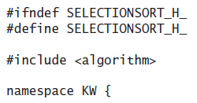
Code for Selection Sort (cont.)

Slide 73
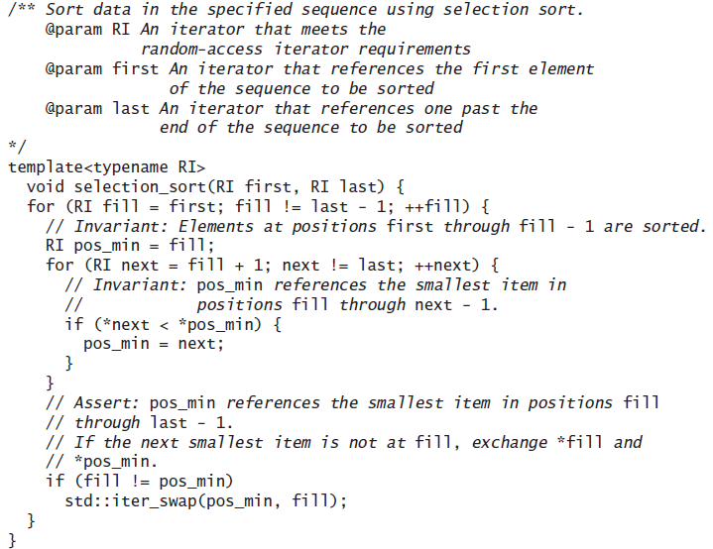
Code for Selection Sort (cont.)

Slide 74
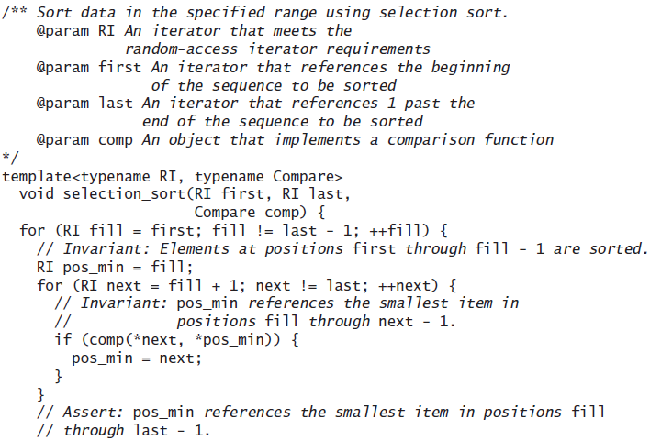
Code for Selection Sort (cont.)

Slide 75
Code for Selection Sort (cont.)

Slide 76
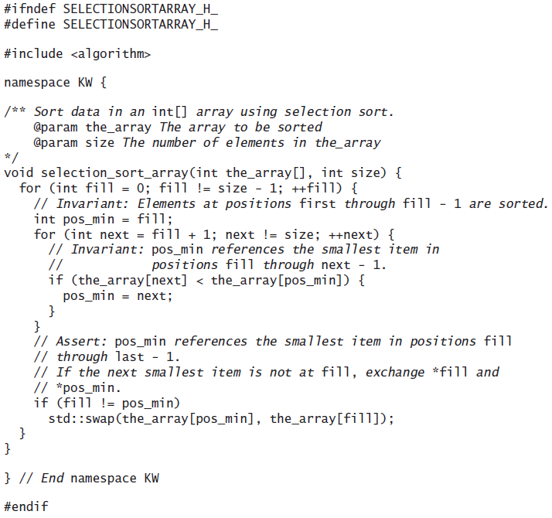
Code for an Array Sort

Slide 77
Bubble Sort
Section 10.3

Slide 78
Bubble Sort
Also a quadratic sort
Compares adjacent array elements and exchanges their values if they are out of order
Smaller values bubble up to the top of the array and larger values sink to the bottom; hence the name

Slide 79
Trace of Bubble Sort
do
for each pair of adjacent array elements
if the values in a pair are out of order
Exchange the values
while the array is not sorted
[0]
60
[1]
42
[2]
75
[3]
83
[4]
27

Slide 80
Trace of Bubble Sort (cont.)
pass | 1
exchanges made | 0
do
for each pair of adjacent array elements
if the values in a pair are out of order
Exchange the values
while the array is not sorted
[0]
60
[1]
42
[2]
75
[3]
83
[4]
27

Slide 81
Trace of Bubble Sort (cont.)
pass | 1
exchanges made | 1
do
for each pair of adjacent array elements
if the values in a pair are out of order
Exchange the values
while the array is not sorted
[0]
42
[1]
60
[2]
75
[3]
83
[4]
27

Slide 82
Trace of Bubble Sort (cont.)
pass | 1
exchanges made | 1
do
for each pair of adjacent array elements
if the values in a pair are out of order
Exchange the values
while the array is not sorted
[0]
42
[1]
60
[2]
75
[3]
83
[4]
27

Slide 83
Trace of Bubble Sort (cont.)
pass | 1
exchanges made | 1
do
for each pair of adjacent array elements
if the values in a pair are out of order
Exchange the values
while the array is not sorted
[0]
42
[1]
60
[2]
75
[3]
83
[4]
27

Slide 84
Trace of Bubble Sort (cont.)
pass | 1
exchanges made | 1
do
for each pair of adjacent array elements
if the values in a pair are out of order
Exchange the values
while the array is not sorted
[0]
42
[1]
60
[2]
75
[3]
83
[4]
27

Slide 85
Trace of Bubble Sort (cont.)
pass | 1
exchanges made | 2
do
for each pair of adjacent array elements
if the values in a pair are out of order
Exchange the values
while the array is not sorted
[0]
42
[1]
60
[2]
75
[3]
27
[4]
83

Slide 86
Trace of Bubble Sort (cont.)
pass | 1
exchanges made | 2
do
for each pair of adjacent array elements
if the values in a pair are out of order
Exchange the values
while the array is not sorted
[0]
42
[1]
60
[2]
75
At the end of pass 1, the last item (index [4]) is guaranteed to be in its correct position. There is no need to test it again in the next pass
[3]
27
[4]
83

Slide 87
Trace of Bubble Sort (cont.)
pass | 2
exchanges made | 0
do
for each pair of adjacent array elements
if the values in a pair are out of order
Exchange the values
while the array is not sorted
[0]
42
[1]
60
[2]
75
[3]
27
[4]
83

Slide 88
Trace of Bubble Sort (cont.)
pass | 2
exchanges made | 0
do
for each pair of adjacent array elements
if the values in a pair are out of order
Exchange the values
while the array is not sorted
[0]
42
[1]
60
[2]
75
[3]
27
[4]
83

Slide 89
Trace of Bubble Sort (cont.)
pass | 2
exchanges made | 0
do
for each pair of adjacent array elements
if the values in a pair are out of order
Exchange the values
while the array is not sorted
[0]
42
[1]
60
[2]
75
[3]
27
[4]
83

Slide 90
Trace of Bubble Sort (cont.)
pass | 2
exchanges made | 1
do
for each pair of adjacent array elements
if the values in a pair are out of order
Exchange the values
while the array is not sorted
[0]
42
[1]
60
[2]
27
[3]
75
[4]
83

Slide 91
Trace of Bubble Sort (cont.)
pass | 2
exchanges made | 1
do
for each pair of adjacent array elements
if the values in a pair are out of order
Exchange the values
while the array is not sorted
[0]
42
[1]
60
[2]
27
[3]
75
[4]
83

Slide 92
Trace of Bubble Sort (cont.)
pass | 3
exchanges made | 0
do
for each pair of adjacent array elements
if the values in a pair are out of order
Exchange the values
while the array is not sorted
[0]
42
[1]
60
[2]
27
[3]
75
[4]
83

Slide 93
Trace of Bubble Sort (cont.)
pass | 3
exchanges made | 0
do
for each pair of adjacent array elements
if the values in a pair are out of order
Exchange the values
while the array is not sorted
[0]
42
[1]
60
[2]
27
[3]
75
[4]
83

Slide 94
Trace of Bubble Sort (cont.)
pass | 3
exchanges made | 1
do
for each pair of adjacent array elements
if the values in a pair are out of order
Exchange the values
while the array is not sorted
[0]
42
[1]
27
[2]
60
[3]
75
[4]
83

Slide 95
Trace of Bubble Sort (cont.)
pass | 3
exchanges made | 1
do
for each pair of adjacent array elements
if the values in a pair are out of order
Exchange the values
while the array is not sorted
[0]
42
[1]
27
[2]
60
[3]
75
[4]
83

Slide 96
Trace of Bubble Sort (cont.)
pass | 4
exchanges made | 0
do
for each pair of adjacent array elements
if the values in a pair are out of order
Exchange the values
while the array is not sorted
[0]
42
[1]
27
[2]
60
[3]
75
[4]
83

Slide 97
Trace of Bubble Sort (cont.)
pass | 4
exchanges made | 1
do
for each pair of adjacent array elements
if the values in a pair are out of order
Exchange the values
while the array is not sorted
[0]
27
[1]
42
[2]
60
[3]
75
[4]
83

Slide 98
Trace of Bubble Sort (cont.)
pass | 4
exchanges made | 1
do
for each pair of adjacent array elements
if the values in a pair are out of order
Exchange the values
while the array is not sorted
[0]
27
[1]
42
[2]
60
[3]
75
[4]
83

Slide 99
Trace of Bubble Sort (cont.)
pass | 4
exchanges made | 1
do
for each pair of adjacent array elements
if the values in a pair are out of order
Exchange the values
while the array is not sorted
[0]
27
[1]
42
[2]
60
Where n is the length of the array, after the completion of n – 1 passes (4, in this example) the array is sorted
[3]
75
[4]
83

Slide 100
Trace of Bubble Sort (cont.)
pass | 4
exchanges made | 1
do
for each pair of adjacent array elements
if the values in a pair are out of order
Exchange the values
while the array is not sorted
[0]
27
[1]
42
[2]
60
Sometimes an array will be sorted before n – 1 passes. This can be detected if there are no exchanges made during a pass through the array
[3]
75
[4]
83

Slide 101
Trace of Bubble Sort (cont.)
pass | 4
exchanges made | 1
do
for each pair of adjacent array elements
if the values in a pair are out of order
Exchange the values
while the array is not sorted
[0]
27
[1]
42
[2]
60
The algorithm can be modified to detect exchanges (next)
[3]
75
[4]
83

Slide 102
Refinement of Bubble Sort Algorithm (Steps 2-4)
2.1 Initialize exchanges to false
2.2 for each pair of adjacent array elements
3. if the values in a pair are out of order
4.1 Exchange the values
4.2 Set exchanges to true

Slide 103
Analysis of Bubble Sort
The number of comparisons and exchanges is represented by
(n – 1) + (n – 2) + ... + 3 + 2 + 1
Worst case:
number of comparisons is O(n²)
number of exchanges is O(n²)
Compared to selection sort with its O(n²) comparisons and O(n) exchanges, bubble sort usually performs worse
If the array is sorted early, the later comparisons and exchanges are not performed and performance is improved

Slide 104
Analysis of Bubble Sort (cont.)
The best case occurs when the array is sorted already
one pass is required (O(n) comparisons)
no exchanges are required (O(1) exchanges)
Bubble sort works well on arrays nearly sorted and worst on inverted arrays (elements are in reverse sorted order)

Slide 105
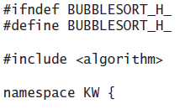
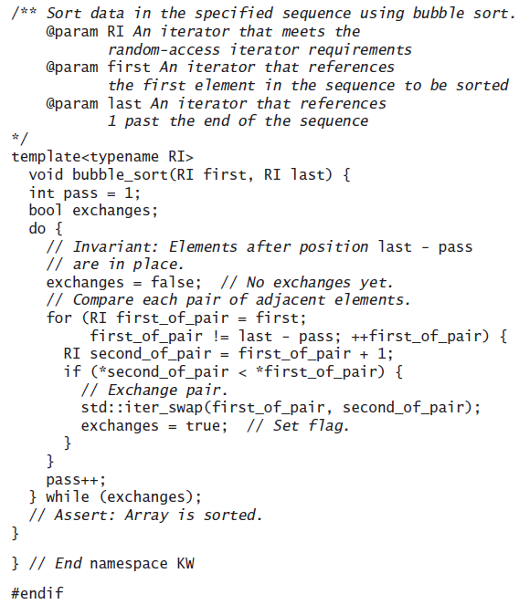
Code for Bubble Sort

Slide 106
Insertion Sort
Section 10.4

Slide 107
Insertion Sort
Another quadratic sort, insertion sort, is based on the technique used by card players to arrange a hand of cards
The player keeps the cards that have been picked up so far in sorted order
When the player picks up a new card, the player makes room for the new card and then inserts it in its proper place

Slide 108
Insertion Sort (cont.)
Start with a sorted subarray, consisting of only the first element
Insert the second element either in front of or behind the first element, producing a sorted subarray of size 2
Insert the third element in front of, between, or behind the first two elements
Continue until all elements have been inserted

Slide 109
Trace of Insertion Sort
for each array element from the second (next_pos = 1) to the last
Insert the element at next_pos where it belongs in the array, increasing the length of the sorted subarray by 1 element
[0]
30
[1]
25
[2]
15
To adapt the insertion algorithm to an array that is filled with data, we start with a sorted subarray consisting of only the first element
[3]
20
[4]
28

Slide 110
Trace of Insertion Sort (cont.)
next_pos | 1
for each array element from the second (next_pos = 1) to the last
Insert the element at next_pos where it belongs in the array, increasing the length of the sorted subarray by 1 element
[0]
30
[1]
25
next_pos
[2]
15
[3]
20
[4]
28

Slide 111
Trace of Insertion Sort (cont.)
next_pos | 1
for each array element from the second (next_pos = 1) to the last
Insert the element at next_pos where it belongs in the array, increasing the length of the sorted subarray by 1 element
[0]
25
[1]
30
next_pos
[2]
15
[3]
20
[4]
28

Slide 112
Trace of Insertion Sort (cont.)
next_pos | 2
for each array element from the second (next_pos = 1) to the last
Insert the element at next_pos where it belongs in the array, increasing the length of the sorted subarray by 1 element
[0]
25
[1]
30
[2]
15
next_pos
[3]
20
[4]
28

Slide 113
Trace of Insertion Sort (cont.)
next_pos | 2
for each array element from the second (next_pos = 1) to the last
Insert the element at next_pos where it belongs in the array, increasing the length of the sorted subarray by 1 element
[0]
15
[1]
25
[2]
30
next_pos
[3]
20
[4]
28

Slide 114
Trace of Insertion Sort (cont.)
next_pos | 3
for each array element from the second (next_pos = 1) to the last
Insert the element at next_pos where it belongs in the array, increasing the length of the sorted subarray by 1 element
[0]
15
[1]
25
[2]
30
[3]
20
next_pos
[4]
28

Slide 115
Trace of Insertion Sort (cont.)
next_pos | 3
for each array element from the second (next_pos = 1) to the last
Insert the element at next_pos where it belongs in the array, increasing the length of the sorted subarray by 1 element
[0]
15
[1]
20
[2]
25
[3]
30
next_pos
[4]
28

Slide 116
Trace of Insertion Sort (cont.)
next_pos | 4
for each array element from the second (next_pos = 1) to the last
Insert the element at next_pos where it belongs in the array, increasing the length of the sorted subarray by 1 element
[0]
15
[1]
20
[2]
25
[3]
30
[4]
28
next_pos

Slide 117
Trace of Insertion Sort (cont.)
next_pos | 4
for each array element from the second (next_pos = 1) to the last
Insert the element at next_pos where it belongs in the array, increasing the length of the sorted subarray by 1 element
[0]
15
[1]
20
[2]
25
[3]
28
[4]
30
next_pos

Slide 118
Trace of Insertion Sort (cont.)
next_pos | -
for each array element from the second (next_pos = 1) to the last
Insert the element at next_pos where it belongs in the array, increasing the length of the sorted subarray by 1 element
[0]
15
[1]
20
[2]
25
[3]
28
[4]
30

Slide 119
Trace of Insertion Sort Refinement
for each array element from the second (next_pos = 1) to the last
next_pos is the position of the element to insert
Save the value of the element to insert in next_val
while next_pos > 0 and the element at next_pos – 1 > next_val
Shift the element at next_pos – 1 to position next_pos
Decrement next_pos by 1
Insert next_val at next_pos
[0]
30
[1]
25
[2]
15
[3]
20
[4]
28

Slide 120
Trace of Insertion Sort Refinement (cont.)
next_pos | 1
next_val
for each array element from the second (next_pos = 1) to the last
next_pos is the position of the element to insert
Save the value of the element to insert in next_val
while next_pos > 0 and the element at next_pos – 1 > next_val
Shift the element at next_pos – 1 to position next_pos
Decrement next_pos by 1
Insert next_val at next_pos
[0]
30
loop position
[1]
25
[2]
15
[3]
20
[4]
28

Slide 121
Trace of Insertion Sort Refinement (cont.)
next_pos | 1
next_val
for each array element from the second (next_pos = 1) to the last
next_pos is the position of the element to insert
Save the value of the element to insert in next_val
while next_pos > 0 and the element at next_pos – 1 > next_val
Shift the element at next_pos – 1 to position next_pos
Decrement next_pos by 1
Insert next_val at next_pos
[0]
30
loop position
[1]
25
next_pos
[2]
15
[3]
20
[4]
28

Slide 122
Trace of Insertion Sort Refinement (cont.)
next_pos | 1
next_val | 25
for each array element from the second (next_pos = 1) to the last
next_pos is the position of the element to insert
Save the value of the element to insert in next_val
while next_pos > 0 and the element at next_pos – 1 > next_val
Shift the element at next_pos – 1 to position next_pos
Decrement next_pos by 1
Insert next_val at next_pos
[0]
30
loop position
[1]
25
next_pos
[2]
15
[3]
20
[4]
28

Slide 123
Trace of Insertion Sort Refinement (cont.)
next_pos | 1
next_val | 25
for each array element from the second (next_pos = 1) to the last
next_pos is the position of the element to insert
Save the value of the element to insert in next_val
while next_pos > 0 and the element at next_pos – 1 > next_val
Shift the element at next_pos – 1 to position next_pos
Decrement next_pos by 1
Insert next_val at next_pos
[0]
30
loop position
[1]
25
next_pos
[2]
15
[3]
20
[4]
28

Slide 124
Trace of Insertion Sort Refinement (cont.)
next_pos | 1
next_val | 25
for each array element from the second (next_pos = 1) to the last
next_pos is the position of the element to insert
Save the value of the element to insert in next_val
while next_pos > 0 and the element at next_pos – 1 > next_val
Shift the element at next_pos – 1 to position next_pos
Decrement next_pos by 1
Insert next_val at next_pos
[0]
30
loop position
[1]
30
next_pos
[2]
15
[3]
20
[4]
28

Slide 125
Trace of Insertion Sort Refinement (cont.)
next_pos | 0
next_val | 25
for each array element from the second (next_pos = 1) to the last
next_pos is the position of the element to insert
Save the value of the element to insert in next_val
while next_pos > 0 and the element at next_pos – 1 > next_val
Shift the element at next_pos – 1 to position next_pos
Decrement next_pos by 1
Insert next_val at next_pos
[0]
30
next_pos
loop position
[1]
30
[2]
15
[3]
20
[4]
28

Slide 126
Trace of Insertion Sort Refinement (cont.)
next_pos | 0
next_val | 25
for each array element from the second (next_pos = 1) to the last
next_pos is the position of the element to insert
Save the value of the element to insert in next_val
while next_pos > 0 and the element at next_pos – 1 > next_val
Shift the element at next_pos – 1 to position next_pos
Decrement next_pos by 1
Insert next_val at next_pos
[0]
30
next_pos
loop position
[1]
30
[2]
15
[3]
20
[4]
28

Slide 127
Trace of Insertion Sort Refinement (cont.)
next_pos | 0
next_val | 25
for each array element from the second (next_pos = 1) to the last
next_pos is the position of the element to insert
Save the value of the element to insert in next_val
while next_pos > 0 and the element at next_pos – 1 > next_val
Shift the element at next_pos – 1 to position next_pos
Decrement next_pos by 1
Insert next_val at next_pos
[0]
25
next_pos
loop position
[1]
30
[2]
15
[3]
20
[4]
28

Slide 128
Trace of Insertion Sort Refinement (cont.)
next_pos | 0
next_val | 25
for each array element from the second (next_pos = 1) to the last
next_pos is the position of the element to insert
Save the value of the element to insert in next_val
while next_pos > 0 and the element at next_pos – 1 > next_val
Shift the element at next_pos – 1 to position next_pos
Decrement next_pos by 1
Insert next_val at next_pos
[0]
25
[1]
30
loop position
[2]
15
[3]
20
[4]
28

Slide 129
Trace of Insertion Sort Refinement (cont.)
next_pos | 2
next_val | 25
for each array element from the second (next_pos = 1) to the last
next_pos is the position of the element to insert
Save the value of the element to insert in next_val
while next_pos > 0 and the element at next_pos – 1 > next_val
Shift the element at next_pos – 1 to position next_pos
Decrement next_pos by 1
Insert next_val at next_pos
[0]
25
[1]
30
loop position
[2]
15
next_pos
[3]
20
[4]
28

Slide 130
Trace of Insertion Sort Refinement (cont.)
next_pos | 2
next_val | 15
for each array element from the second (next_pos = 1) to the last
next_pos is the position of the element to insert
Save the value of the element to insert in next_val
while next_pos > 0 and the element at next_pos – 1 > next_val
Shift the element at next_pos – 1 to position next_pos
Decrement next_pos by 1
Insert next_val at next_pos
[0]
25
[1]
30
loop position
[2]
15
next_pos
[3]
20
[4]
28

Slide 131
Trace of Insertion Sort Refinement (cont.)
next_pos | 2
next_val | 15
for each array element from the second (next_pos = 1) to the last
next_pos is the position of the element to insert
Save the value of the element to insert in next_val
while next_pos > 0 and the element at next_pos – 1 > next_val
Shift the element at next_pos – 1 to position next_pos
Decrement next_pos by 1
Insert next_val at next_pos
[0]
25
[1]
30
loop position
[2]
15
next_pos
[3]
20
[4]
28

Slide 132
Trace of Insertion Sort Refinement (cont.)
next_pos | 2
next_val | 15
for each array element from the second (next_pos = 1) to the last
next_pos is the position of the element to insert
Save the value of the element to insert in next_val
while next_pos > 0 and the element at next_pos – 1 > next_val
Shift the element at next_pos – 1 to position next_pos
Decrement next_pos by 1
Insert next_val at next_pos
[0]
25
[1]
30
loop position
[2]
30
next_pos
[3]
20
[4]
28

Slide 133
Trace of Insertion Sort Refinement (cont.)
next_pos | 1
next_val | 15
for each array element from the second (next_pos = 1) to the last
next_pos is the position of the element to insert
Save the value of the element to insert in next_val
while next_pos > 0 and the element at next_pos – 1 > next_val
Shift the element at next_pos – 1 to position next_pos
Decrement next_pos by 1
Insert next_val at next_pos
[0]
25
[1]
30
next_pos
loop position
[2]
30
[3]
20
[4]
28

Slide 134
Trace of Insertion Sort Refinement (cont.)
next_pos | 1
next_val | 15
for each array element from the second (next_pos = 1) to the last
next_pos is the position of the element to insert
Save the value of the element to insert in next_val
while next_pos > 0 and the element at next_pos – 1 > next_val
Shift the element at next_pos – 1 to position next_pos
Decrement next_pos by 1
Insert next_val at next_pos
[0]
25
[1]
30
next_pos
loop position
[2]
30
[3]
20
[4]
28

Slide 135
Trace of Insertion Sort Refinement (cont.)
next_pos | 1
next_val | 15
for each array element from the second (next_pos = 1) to the last
next_pos is the position of the element to insert
Save the value of the element to insert in next_val
while next_pos > 0 and the element at next_pos – 1 > next_val
Shift the element at next_pos – 1 to position next_pos
Decrement next_pos by 1
Insert next_val at next_pos
[0]
25
[1]
25
next_pos
loop position
[2]
30
[3]
20
[4]
28

Slide 136
Trace of Insertion Sort Refinement (cont.)
next_pos | 0
next_val | 15
for each array element from the second (next_pos = 1) to the last
next_pos is the position of the element to insert
Save the value of the element to insert in next_val
while next_pos > 0 and the element at next_pos – 1 > next_val
Shift the element at next_pos – 1 to position next_pos
Decrement next_pos by 1
Insert next_val at next_pos
[0]
25
next_pos
[1]
25
loop position
[2]
30
[3]
20
[4]
28

Slide 137
Trace of Insertion Sort Refinement (cont.)
next_pos | 0
next_val | 15
for each array element from the second (next_pos = 1) to the last
next_pos is the position of the element to insert
Save the value of the element to insert in next_val
while next_pos > 0 and the element at next_pos – 1 > next_val
Shift the element at next_pos – 1 to position next_pos
Decrement next_pos by 1
Insert next_val at next_pos
[0]
25
next_pos
[1]
25
loop position
[2]
30
[3]
20
[4]
28

Slide 138
Trace of Insertion Sort Refinement (cont.)
next_pos | 0
next_val | 15
for each array element from the second (next_pos = 1) to the last
next_pos is the position of the element to insert
Save the value of the element to insert in next_val
while next_pos > 0 and the element at next_pos – 1 > next_val
Shift the element at next_pos – 1 to position next_pos
Decrement next_pos by 1
Insert next_val at next_pos
[0]
15
next_pos
[1]
25
loop position
[2]
30
[3]
20
[4]
28

Slide 139
Trace of Insertion Sort Refinement (cont.)
next_pos | 0
next_val | 15
for each array element from the second (next_pos = 1) to the last
next_pos is the position of the element to insert
Save the value of the element to insert in next_val
while next_pos > 0 and the element at next_pos – 1 > next_val
Shift the element at next_pos – 1 to position next_pos
Decrement next_pos by 1
Insert next_val at next_pos
[0]
15
next_pos
[1]
25
[2]
30
loop position
[3]
20
[4]
28

Slide 140
Trace of Insertion Sort Refinement (cont.)
next_pos | 3
next_val | 15
for each array element from the second (next_pos = 1) to the last
next_pos is the position of the element to insert
Save the value of the element to insert in next_val
while next_pos > 0 and the element at next_pos – 1 > next_val
Shift the element at next_pos – 1 to position next_pos
Decrement next_pos by 1
Insert next_val at next_pos
[0]
15
[1]
25
[2]
30
loop position
[3]
20
next_pos
[4]
28

Slide 141
Trace of Insertion Sort Refinement (cont.)
next_pos | 3
next_val | 20
for each array element from the second (next_pos = 1) to the last
next_pos is the position of the element to insert
Save the value of the element to insert in next_val
while next_pos > 0 and the element at next_pos – 1 > next_val
Shift the element at next_pos – 1 to position next_pos
Decrement next_pos by 1
Insert next_val at next_pos
[0]
15
[1]
25
[2]
30
loop position
[3]
20
next_pos
[4]
28

Slide 142
Trace of Insertion Sort Refinement (cont.)
next_pos | 3
next_val | 20
for each array element from the second (next_pos = 1) to the last
next_pos is the position of the element to insert
Save the value of the element to insert in next_val
while next_pos > 0 and the element at next_pos – 1 > next_val
Shift the element at next_pos – 1 to position next_pos
Decrement next_pos by 1
Insert next_val at next_pos
[0]
15
[1]
25
[2]
30
loop position
[3]
20
next_pos
[4]
28

Slide 143
Trace of Insertion Sort Refinement (cont.)
next_pos | 3
next_val | 20
for each array element from the second (next_pos = 1) to the last
next_pos is the position of the element to insert
Save the value of the element to insert in next_val
while next_pos > 0 and the element at next_pos – 1 > next_val
Shift the element at next_pos – 1 to position next_pos
Decrement next_pos by 1
Insert next_val at next_pos
[0]
15
[1]
25
[2]
30
loop position
[3]
30
next_pos
[4]
28

Slide 144
Trace of Insertion Sort Refinement (cont.)
next_pos | 2
next_val | 20
for each array element from the second (next_pos = 1) to the last
next_pos is the position of the element to insert
Save the value of the element to insert in next_val
while next_pos > 0 and the element at next_pos – 1 > next_val
Shift the element at next_pos – 1 to position next_pos
Decrement next_pos by 1
Insert next_val at next_pos
[0]
15
[1]
25
[2]
30
next_pos
loop position
[3]
30
[4]
28

Slide 145
Trace of Insertion Sort Refinement (cont.)
next_pos | 2
next_val | 20
for each array element from the second (next_pos = 1) to the last
next_pos is the position of the element to insert
Save the value of the element to insert in next_val
while next_pos > 0 and the element at next_pos – 1 > next_val
Shift the element at next_pos – 1 to position next_pos
Decrement next_pos by 1
Insert next_val at next_pos
[0]
15
[1]
25
[2]
30
next_pos
loop position
[3]
30
[4]
28

Slide 146
Trace of Insertion Sort Refinement (cont.)
next_pos | 2
next_val | 20
for each array element from the second (next_pos = 1) to the last
next_pos is the position of the element to insert
Save the value of the element to insert in next_val
while next_pos > 0 and the element at next_pos – 1 > next_val
Shift the element at next_pos – 1 to position next_pos
Decrement next_pos by 1
Insert next_val at next_pos
[0]
15
[1]
25
[2]
25
next_pos
loop position
[3]
30
[4]
28

Slide 147
Trace of Insertion Sort Refinement (cont.)
next_pos | 1
next_val | 20
for each array element from the second (next_pos = 1) to the last
next_pos is the position of the element to insert
Save the value of the element to insert in next_val
while next_pos > 0 and the element at next_pos – 1 > next_val
Shift the element at next_pos – 1 to position next_pos
Decrement next_pos by 1
Insert next_val at next_pos
[0]
15
[1]
25
next_pos
[2]
25
loop position
[3]
30
[4]
28

Slide 148
Trace of Insertion Sort Refinement (cont.)
next_pos | 1
next_val | 20
for each array element from the second (next_pos = 1) to the last
next_pos is the position of the element to insert
Save the value of the element to insert in next_val
while next_pos > 0 and the element at next_pos – 1 > next_val
Shift the element at next_pos – 1 to position next_pos
Decrement next_pos by 1
Insert next_val at next_pos
[0]
15
[1]
25
next_pos
[2]
25
loop position
[3]
30
[4]
28

Slide 149
Trace of Insertion Sort Refinement (cont.)
next_pos | 1
next_val | 20
for each array element from the second (next_pos = 1) to the last
next_pos is the position of the element to insert
Save the value of the element to insert in next_val
while next_pos > 0 and the element at next_pos – 1 > next_val
Shift the element at next_pos – 1 to position next_pos
Decrement next_pos by 1
Insert next_val at next_pos
[0]
15
[1]
20
next_pos
[2]
25
loop position
[3]
30
[4]
28

Slide 150
Trace of Insertion Sort Refinement (cont.)
next_pos | 1
next_val | 20
for each array element from the second (next_pos = 1) to the last
next_pos is the position of the element to insert
Save the value of the element to insert in next_val
while next_pos > 0 and the element at next_pos – 1 > next_val
Shift the element at next_pos – 1 to position next_pos
Decrement next_pos by 1
Insert next_val at next_pos
[0]
15
[1]
20
[2]
25
[3]
30
loop position
[4]
28

Slide 151
Trace of Insertion Sort Refinement (cont.)
next_pos | 4
next_val | 20
for each array element from the second (next_pos = 1) to the last
next_pos is the position of the element to insert
Save the value of the element to insert in next_val
while next_pos > 0 and the element at next_pos – 1 > next_val
Shift the element at next_pos – 1 to position next_pos
Decrement next_pos by 1
Insert next_val at next_pos
[0]
15
[1]
20
[2]
25
[3]
30
loop position
[4]
28
next_pos

Slide 152
Trace of Insertion Sort Refinement (cont.)
next_pos | 4
next_val | 28
for each array element from the second (next_pos = 1) to the last
next_pos is the position of the element to insert
Save the value of the element to insert in next_val
while next_pos > 0 and the element at next_pos – 1 > next_val
Shift the element at next_pos – 1 to position next_pos
Decrement next_pos by 1
Insert next_val at next_pos
[0]
15
[1]
20
[2]
25
[3]
30
loop position
[4]
28
next_pos

Slide 153
Trace of Insertion Sort Refinement (cont.)
next_pos | 4
next_val | 28
for each array element from the second (next_pos = 1) to the last
next_pos is the position of the element to insert
Save the value of the element to insert in next_val
while next_pos > 0 and the element at next_pos – 1 > next_val
Shift the element at next_pos – 1 to position next_pos
Decrement next_pos by 1
Insert next_val at next_pos
[0]
15
[1]
20
[2]
25
[3]
30
loop position
[4]
28
next_pos

Slide 154
Trace of Insertion Sort Refinement (cont.)
next_pos | 4
next_val | 28
for each array element from the second (next_pos = 1) to the last
next_pos is the position of the element to insert
Save the value of the element to insert in next_val
while next_pos > 0 and the element at next_pos – 1 > next_val
Shift the element at next_pos – 1 to position next_pos
Decrement next_pos by 1
Insert next_val at next_pos
[0]
15
[1]
20
[2]
25
[3]
30
loop position
[4]
30
next_pos

Slide 155
Trace of Insertion Sort Refinement (cont.)
next_pos | 3
next_val | 28
for each array element from the second (next_pos = 1) to the last
next_pos is the position of the element to insert
Save the value of the element to insert in next_val
while next_pos > 0 and the element at next_pos – 1 > next_val
Shift the element at next_pos – 1 to position next_pos
Decrement next_pos by 1
Insert next_val at next_pos
[0]
15
[1]
20
[2]
25
[3]
30
next_pos
loop position
[4]
30

Slide 156
Trace of Insertion Sort Refinement (cont.)
next_pos | 3
next_val | 28
for each array element from the second (next_pos = 1) to the last
next_pos is the position of the element to insert
Save the value of the element to insert in next_val
while next_pos > 0 and the element at next_pos – 1 > next_val
Shift the element at next_pos – 1 to position next_pos
Decrement next_pos by 1
Insert next_val at next_pos
[0]
15
[1]
20
[2]
25
[3]
30
next_pos
loop position
[4]
30

Slide 157
Trace of Insertion Sort Refinement (cont.)
next_pos | 3
next_val | 28
for each array element from the second (next_pos = 1) to the last
next_pos is the position of the element to insert
Save the value of the element to insert in next_val
while next_pos > 0 and the element at next_pos – 1 > next_val
Shift the element at next_pos – 1 to position next_pos
Decrement next_pos by 1
Insert next_val at next_pos
[0]
15
[1]
20
[2]
25
[3]
28
next_pos
loop position
[4]
30

Slide 158
Trace of Insertion Sort Refinement (cont.)
next_pos | 3
next_val | 28
for each array element from the second (next_pos = 1) to the last
next_pos is the position of the element to insert
Save the value of the element to insert in next_val
while next_pos > 0 and the element at next_pos – 1 > next_val
Shift the element at next_pos – 1 to position next_pos
Decrement next_pos by 1
Insert next_val at next_pos
[0]
15
[1]
20
[2]
25
[3]
28
[4]
30

Slide 159
Analysis of Insertion Sort
The insertion step is performed n – 1 times
In the worst case, all elements in the sorted subarray are compared to next_val for each insertion
The maximum number of comparisons then will be:
1 + 2 + 3 + ... + (n – 2) + (n – 1)
which is O(n²)

Slide 160
Analysis of Insertion Sort (cont.)
In the best case (when the array is sorted already), only one comparison is required for each insertion
In the best case, the number of comparisons is O(n)
The number of shifts performed during an insertion is one less than the number of comparisons
Or, when the new value is the smallest so far, it is the same as the number of comparisons
A shift in an insertion sort requires movement of only 1 item, while an exchange in a bubble or selection sort involves a temporary item and the movement of three items
A C++ array of objects contains the actual objects, and it is these actual objects that are changed

Slide 161
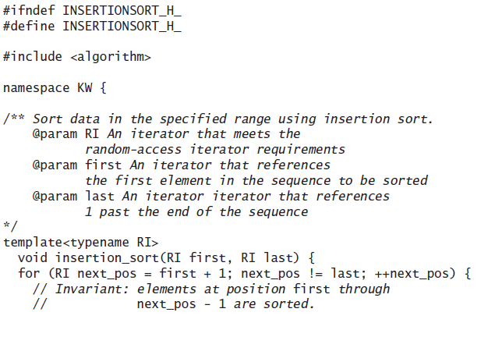
Code for Insertion Sort

Slide 162
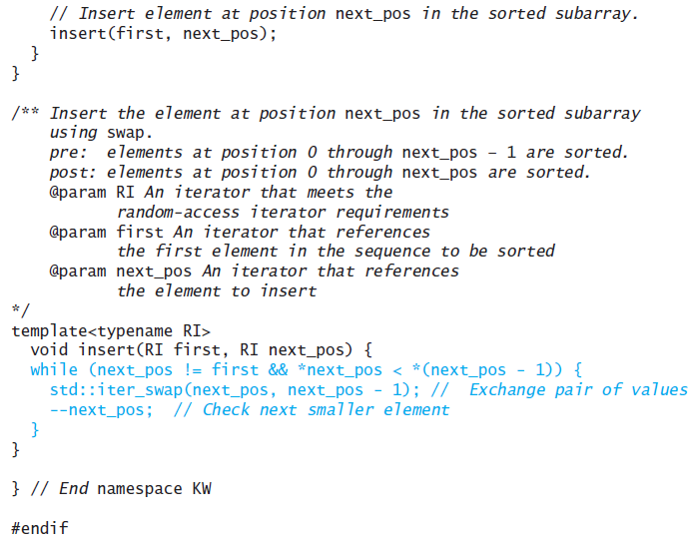
Code for Insertion Sort

Slide 163
Using iterator_traits to Determine the Data Type of an Element
The following version of function insert follows the algorithm more closely
typename std::iterator_traits<RI>::value_type next_val = *next_pos;
The statement above declares variable next_val and stores the element referenced by next_pos in it
The template class iterator_traits is defined in the header <iterator>, and value_type represents the data type of the element referenced by the iterator next_pos

Slide 164
Using iterator_traits to Determine the Data Type of an Element (cont.)
template<typename RI>
void insert(RI first, RI next_pos) {
typename std::iterator_traits<RI>::value_type next_val
= *next_pos; // next_val is element to insert.
while (next_pos != first && next_val < *(next_pos - 1)) {
*next_pos = *(next_pos - 1);
--next_pos; // Check next smaller element.
}
*next_pos = next_val; // Store next_val where it belongs.
}

Slide 165
Comparison of Quadratic Sorts
Section 10.5

Slide 166
Comparison of Quadratic Sorts

Slide 167
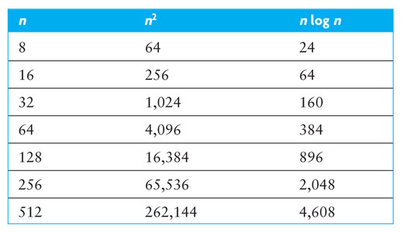
Comparison of Quadratic Sorts (cont.)
Comparison of growth rates

Slide 168
Comparison of Quadratic Sorts (cont.)
Insertion sort
gives the best performance for most arrays
takes advantage of any partial sorting in the array and uses less costly shifts
Bubble sort generally gives the worst performance—unless the array is nearly sorted
Big-O analysis ignores constants and overhead
None of the quadratic sort algorithms are particularly good for large arrays (n > 100)
The best sorting algorithms provide n log n average case performance

Slide 169
Comparison of Quadratic Sorts (cont.)
All quadratic sorts require storage for the array being sorted
However, the array is sorted in place
While there are also storage requirements for variables, for large n, the size of the array dominates and extra space usage is O(1)

Slide 170
Comparisons versus Exchanges
In C++, an exchange requires a swap of two objects using a third object as an intermediary
A comparison requires an evaluation of the < operator, or a call to a comparison function
The cost of a comparison depends on its complexity, but is generally more costly than an exchange
The cost of an exchange is proportional to the size of the objects being exchanged and, therefore, may be more costly than a comparison for large objects

Slide 171
Shell Sort: A Better Insertion Sort
Section 10.6

Slide 172
Shell Sort: A Better Insertion Sort
A Shell sort is a type of insertion sort, but with O(n^{3/2}) or better performance than the O(n²) sorts
It is named after its discoverer, Donald Shell
A Shell sort can be thought of as a divide-and-conquer approach to insertion sort
Instead of sorting the entire array, Shell sort sorts many smaller subarrays using insertion sort before sorting the entire array

Slide 173
Trace of Shell Sort
gap value | 7
[0]
[1]
[2]
[3]
[4]
[5]
[6]
[7]
[8]
[9]
[10]
[11]
[12]
[13]
[14]
[15]
40
35
80
75
60
90
70
75
55
90
85
34
45
62
57
65

Slide 174
Trace of Shell Sort (cont.)
gap value | 7
[0]
[1]
[2]
[3]
[4]
[5]
[6]
[7]
[8]
[9]
[10]
[11]
[12]
[13]
[14]
[15]
40
35
80
75
60
90
70
75
55
90
85
34
45
62
57
65
subarray 1

Slide 175
Trace of Shell Sort (cont.)
gap value | 7
[0]
[1]
[2]
[3]
[4]
[5]
[6]
[7]
[8]
[9]
[10]
[11]
[12]
[13]
[14]
[15]
40
35
80
75
60
90
70
75
55
90
85
34
45
62
57
65
subarray 2

Slide 176
Trace of Shell Sort (cont.)
gap value | 7
[0]
[1]
[2]
[3]
[4]
[5]
[6]
[7]
[8]
[9]
[10]
[11]
[12]
[13]
[14]
[15]
40
35
80
75
60
90
70
75
55
90
85
34
45
62
57
65
subarray 3

Slide 177
Trace of Shell Sort (cont.)
gap value | 7
[0]
[1]
[2]
[3]
[4]
[5]
[6]
[7]
[8]
[9]
[10]
[11]
[12]
[13]
[14]
[15]
40
35
80
75
60
90
70
75
55
90
85
34
45
62
57
65
subarray 4

Slide 178
Trace of Shell Sort (cont.)
gap value | 7
[0]
[1]
[2]
[3]
[4]
[5]
[6]
[7]
[8]
[9]
[10]
[11]
[12]
[13]
[14]
[15]
40
35
80
75
60
90
70
75
55
90
85
34
45
62
57
65
subarray 5

Slide 179
Trace of Shell Sort (cont.)
gap value | 7
[0]
[1]
[2]
[3]
[4]
[5]
[6]
[7]
[8]
[9]
[10]
[11]
[12]
[13]
[14]
[15]
40
35
80
75
60
90
70
75
55
90
85
34
45
62
57
65
subarray 6

Slide 180
Trace of Shell Sort (cont.)
gap value | 7
[0]
[1]
[2]
[3]
[4]
[5]
[6]
[7]
[8]
[9]
[10]
[11]
[12]
[13]
[14]
[15]
40
35
80
75
60
90
70
75
55
90
85
34
45
62
57
65
subarray 7

Slide 181
Trace of Shell Sort (cont.)
gap value | 7
Sort subarray 1
[0]
[1]
[2]
[3]
[4]
[5]
[6]
[7]
[8]
[9]
[10]
[11]
[12]
[13]
[14]
[15]
40
35
80
75
60
90
70
75
55
90
85
34
45
62
57
65
subarray 1

Slide 182
Trace of Shell Sort (cont.)
gap value | 7
Sort subarray 2
[0]
[1]
[2]
[3]
[4]
[5]
[6]
[7]
[8]
[9]
[10]
[11]
[12]
[13]
[14]
[15]
40
35
80
75
60
90
70
75
55
90
85
34
45
62
57
65
subarray 2

Slide 183
Trace of Shell Sort (cont.)
gap value | 7
Sort subarray 3
[0]
[1]
[2]
[3]
[4]
[5]
[6]
[7]
[8]
[9]
[10]
[11]
[12]
[13]
[14]
[15]
40
35
80
75
60
90
70
75
55
90
85
34
45
62
57
65
subarray 3

Slide 184
Trace of Shell Sort (cont.)
gap value | 7
Sort subarray 4
[0]
[1]
[2]
[3]
[4]
[5]
[6]
[7]
[8]
[9]
[10]
[11]
[12]
[13]
[14]
[15]
40
35
80
75
60
90
70
75
55
90
85
34
45
62
57
65
subarray 4

Slide 185
Trace of Shell Sort (cont.)
gap value | 7
Sort subarray 5
[0]
[1]
[2]
[3]
[4]
[5]
[6]
[7]
[8]
[9]
[10]
[11]
[12]
[13]
[14]
[15]
40
35
80
75
60
90
70
75
55
90
85
34
45
62
57
65
subarray 5

Slide 186
Trace of Shell Sort (cont.)
gap value | 7
Sort subarray 5
[0]
[1]
[2]
[3]
[4]
[5]
[6]
[7]
[8]
[9]
[10]
[11]
[12]
[13]
[14]
[15]
40
35
80
75
34
90
70
75
55
90
85
60
45
62
57
65
subarray 5

Slide 187
Trace of Shell Sort (cont.)
gap value | 7
Sort subarray 6
[0]
[1]
[2]
[3]
[4]
[5]
[6]
[7]
[8]
[9]
[10]
[11]
[12]
[13]
[14]
[15]
40
35
80
75
34
90
70
75
55
90
85
60
45
62
57
65
subarray 6

Slide 188
Trace of Shell Sort (cont.)
gap value | 7
Sort subarray 6
[0]
[1]
[2]
[3]
[4]
[5]
[6]
[7]
[8]
[9]
[10]
[11]
[12]
[13]
[14]
[15]
40
35
80
75
34
45
70
75
55
90
85
60
90
62
57
65
subarray 6

Slide 189
Trace of Shell Sort (cont.)
gap value | 7
Sort subarray 7
[0]
[1]
[2]
[3]
[4]
[5]
[6]
[7]
[8]
[9]
[10]
[11]
[12]
[13]
[14]
[15]
40
35
80
75
34
45
70
75
55
90
85
60
90
62
57
65
subarray 7

Slide 190
Trace of Shell Sort (cont.)
gap value | 7
Sort subarray 7
[0]
[1]
[2]
[3]
[4]
[5]
[6]
[7]
[8]
[9]
[10]
[11]
[12]
[13]
[14]
[15]
40
35
80
75
34
45
62
75
55
90
85
60
90
70
57
65
subarray 7

Slide 191
Trace of Shell Sort (cont.)
gap value | 7
Sort subarray 1
[0]
[1]
[2]
[3]
[4]
[5]
[6]
[7]
[8]
[9]
[10]
[11]
[12]
[13]
[14]
[15]
40
35
80
75
34
45
62
57
55
90
85
60
90
70
75
65
subarray 1

Slide 192
Trace of Shell Sort (cont.)
gap value | 7
Sort subarray 2
[0]
[1]
[2]
[3]
[4]
[5]
[6]
[7]
[8]
[9]
[10]
[11]
[12]
[13]
[14]
[15]
40
35
80
75
34
45
62
57
55
90
85
60
90
70
75
65
subarray 2

Slide 193
Trace of Shell Sort (cont.)
gap value | 7
Sort on smaller gap value next
[0]
[1]
[2]
[3]
[4]
[5]
[6]
[7]
[8]
[9]
[10]
[11]
[12]
[13]
[14]
[15]
40
35
80
75
34
45
62
57
55
90
85
60
90
70
75
65

Slide 194
Trace of Shell Sort (cont.)
gap value | 3
Sort on smaller gap value
[0]
[1]
[2]
[3]
[4]
[5]
[6]
[7]
[8]
[9]
[10]
[11]
[12]
[13]
[14]
[15]
40
35
80
75
34
45
62
57
55
90
85
60
90
70
75
65

Slide 195
Trace of Shell Sort (cont.)
gap value | 3
Sort subarray 1
[0]
[1]
[2]
[3]
[4]
[5]
[6]
[7]
[8]
[9]
[10]
[11]
[12]
[13]
[14]
[15]
40
35
80
75
34
45
62
57
55
90
85
60
90
70
75
65
subarray 1

Slide 196
Trace of Shell Sort (cont.)
gap value | 3
Sort subarray 2
[0]
[1]
[2]
[3]
[4]
[5]
[6]
[7]
[8]
[9]
[10]
[11]
[12]
[13]
[14]
[15]
40
35
80
75
34
45
62
57
55
90
85
60
90
70
75
65
subarray 2

Slide 197
Trace of Shell Sort (cont.)
gap value | 3
Sort subarray 2
[0]
[1]
[2]
[3]
[4]
[5]
[6]
[7]
[8]
[9]
[10]
[11]
[12]
[13]
[14]
[15]
40
34
80
75
35
45
62
57
55
90
85
60
90
70
75
65
subarray 2

Slide 198
Trace of Shell Sort (cont.)
gap value | 3
Sort subarray 3
[0]
[1]
[2]
[3]
[4]
[5]
[6]
[7]
[8]
[9]
[10]
[11]
[12]
[13]
[14]
[15]
40
34
80
75
35
45
62
57
55
90
85
60
90
70
75
65
subarray 3

Slide 199
Trace of Shell Sort (cont.)
gap value | 3
Sort subarray 3
[0]
[1]
[2]
[3]
[4]
[5]
[6]
[7]
[8]
[9]
[10]
[11]
[12]
[13]
[14]
[15]
40
34
45
75
35
80
62
57
55
90
85
60
90
70
75
65
subarray 3

Slide 200
Trace of Shell Sort (cont.)
gap value | 3
Sort subarray 1
[0]
[1]
[2]
[3]
[4]
[5]
[6]
[7]
[8]
[9]
[10]
[11]
[12]
[13]
[14]
[15]
40
34
45
75
35
80
62
57
55
90
85
60
90
70
75
65
subarray 1

Slide 201
Trace of Shell Sort (cont.)
gap value | 3
Sort subarray 1
[0]
[1]
[2]
[3]
[4]
[5]
[6]
[7]
[8]
[9]
[10]
[11]
[12]
[13]
[14]
[15]
40
34
45
62
35
80
75
57
55
90
85
60
90
70
75
65
subarray 1

Slide 202
Trace of Shell Sort (cont.)
gap value | 3
Sort subarray 2
[0]
[1]
[2]
[3]
[4]
[5]
[6]
[7]
[8]
[9]
[10]
[11]
[12]
[13]
[14]
[15]
40
34
45
62
35
80
75
57
55
90
85
60
90
70
75
65
subarray 2

Slide 203
Trace of Shell Sort (cont.)
gap value | 3
Sort subarray 3
[0]
[1]
[2]
[3]
[4]
[5]
[6]
[7]
[8]
[9]
[10]
[11]
[12]
[13]
[14]
[15]
40
34
45
62
35
80
75
57
55
90
85
60
90
70
75
65
subarray 3

Slide 204
Trace of Shell Sort (cont.)
gap value | 3
Sort subarray 3
[0]
[1]
[2]
[3]
[4]
[5]
[6]
[7]
[8]
[9]
[10]
[11]
[12]
[13]
[14]
[15]
40
34
45
62
35
55
75
57
80
90
85
60
90
70
75
65
subarray 3

Slide 205
Trace of Shell Sort (cont.)
gap value | 3
Sort subarray 1
[0]
[1]
[2]
[3]
[4]
[5]
[6]
[7]
[8]
[9]
[10]
[11]
[12]
[13]
[14]
[15]
40
34
45
62
35
55
75
57
80
90
85
60
90
70
75
65
subarray 1

Slide 206
Trace of Shell Sort (cont.)
gap value | 3
Sort subarray 2
[0]
[1]
[2]
[3]
[4]
[5]
[6]
[7]
[8]
[9]
[10]
[11]
[12]
[13]
[14]
[15]
40
34
45
62
35
55
75
57
80
90
85
60
90
70
75
65
subarray 2

Slide 207
Trace of Shell Sort (cont.)
gap value | 3
Sort subarray 3
[0]
[1]
[2]
[3]
[4]
[5]
[6]
[7]
[8]
[9]
[10]
[11]
[12]
[13]
[14]
[15]
40
34
45
62
35
55
75
57
80
90
85
60
90
70
75
65
subarray 3

Slide 208
Trace of Shell Sort (cont.)
gap value | 3
Sort subarray 3
[0]
[1]
[2]
[3]
[4]
[5]
[6]
[7]
[8]
[9]
[10]
[11]
[12]
[13]
[14]
[15]
40
34
45
62
35
55
75
57
60
90
85
80
90
70
75
65
subarray 3

Slide 209
Trace of Shell Sort (cont.)
gap value | 3
Sort subarray 1
[0]
[1]
[2]
[3]
[4]
[5]
[6]
[7]
[8]
[9]
[10]
[11]
[12]
[13]
[14]
[15]
40
34
45
62
35
55
75
57
60
90
85
80
90
70
75
65
subarray 1

Slide 210
Trace of Shell Sort (cont.)
gap value | 3
Sort subarray 2
[0]
[1]
[2]
[3]
[4]
[5]
[6]
[7]
[8]
[9]
[10]
[11]
[12]
[13]
[14]
[15]
40
34
45
62
35
55
75
57
60
90
85
80
90
70
75
65
subarray 2

Slide 211
Trace of Shell Sort (cont.)
gap value | 3
Sort subarray 2
[0]
[1]
[2]
[3]
[4]
[5]
[6]
[7]
[8]
[9]
[10]
[11]
[12]
[13]
[14]
[15]
40
34
45
62
35
55
75
57
60
90
70
80
90
85
75
65
subarray 2

Slide 212
Trace of Shell Sort (cont.)
gap value | 3
Sort subarray 3
[0]
[1]
[2]
[3]
[4]
[5]
[6]
[7]
[8]
[9]
[10]
[11]
[12]
[13]
[14]
[15]
40
34
45
62
35
55
75
57
60
90
70
80
90
85
75
65
subarray 3

Slide 213
Trace of Shell Sort (cont.)
gap value | 3
Sort subarray 3
[0]
[1]
[2]
[3]
[4]
[5]
[6]
[7]
[8]
[9]
[10]
[11]
[12]
[13]
[14]
[15]
40
34
45
62
35
55
75
57
60
90
70
75
90
85
80
65
subarray 3

Slide 214
Trace of Shell Sort (cont.)
gap value | 3
Sort subarray 1
[0]
[1]
[2]
[3]
[4]
[5]
[6]
[7]
[8]
[9]
[10]
[11]
[12]
[13]
[14]
[15]
40
34
45
62
35
55
75
57
60
90
70
75
90
85
80
65
subarray 1

Slide 215
Trace of Shell Sort (cont.)
gap value | 3
Sort subarray 1
[0]
[1]
[2]
[3]
[4]
[5]
[6]
[7]
[8]
[9]
[10]
[11]
[12]
[13]
[14]
[15]
40
34
45
62
35
55
75
57
60
65
70
75
90
85
80
90
subarray 1

Slide 216
Trace of Shell Sort (cont.)
gap value | 3
Sort subarray 1
[0]
[1]
[2]
[3]
[4]
[5]
[6]
[7]
[8]
[9]
[10]
[11]
[12]
[13]
[14]
[15]
40
34
45
62
35
55
65
57
60
75
70
75
90
85
80
90
subarray 1

Slide 217
Trace of Shell Sort (cont.)
gap value | 3
Sort on gap value of 1 (a regular insertion sort)
[0]
[1]
[2]
[3]
[4]
[5]
[6]
[7]
[8]
[9]
[10]
[11]
[12]
[13]
[14]
[15]
40
34
45
62
35
55
65
57
60
75
70
75
90
85
80
90

Slide 218
Trace of Shell Sort (cont.)
gap value | 1
Sort on gap value of 1 (a regular insertion sort)
[0]
[1]
[2]
[3]
[4]
[5]
[6]
[7]
[8]
[9]
[10]
[11]
[12]
[13]
[14]
[15]
40
34
45
62
35
55
65
57
60
75
70
75
90
85
80
90

Slide 219
Trace of Shell Sort (cont.)
gap value | 1
Sort on gap value of 1 (a regular insertion sort)
[0]
[1]
[2]
[3]
[4]
[5]
[6]
[7]
[8]
[9]
[10]
[11]
[12]
[13]
[14]
[15]
40
34
45
62
35
55
65
57
60
75
70
75
90
85
80
90

Slide 220
Trace of Shell Sort (cont.)
gap value | 1
Sort on gap value of 1 (a regular insertion sort)
[0]
[1]
[2]
[3]
[4]
[5]
[6]
[7]
[8]
[9]
[10]
[11]
[12]
[13]
[14]
[15]
34
40
45
62
35
55
65
57
60
75
70
75
90
85
80
90

Slide 221
Trace of Shell Sort (cont.)
gap value | 1
Sort on gap value of 1 (a regular insertion sort)
[0]
[1]
[2]
[3]
[4]
[5]
[6]
[7]
[8]
[9]
[10]
[11]
[12]
[13]
[14]
[15]
34
40
45
62
35
55
65
57
60
75
70
75
90
85
80
90

Slide 222
Trace of Shell Sort (cont.)
gap value | 1
Sort on gap value of 1 (a regular insertion sort)
[0]
[1]
[2]
[3]
[4]
[5]
[6]
[7]
[8]
[9]
[10]
[11]
[12]
[13]
[14]
[15]
34
40
45
62
35
55
65
57
60
75
70
75
90
85
80
90

Slide 223
Trace of Shell Sort (cont.)
gap value | 1
Sort on gap value of 1 (a regular insertion sort)
[0]
[1]
[2]
[3]
[4]
[5]
[6]
[7]
[8]
[9]
[10]
[11]
[12]
[13]
[14]
[15]
34
40
45
62
35
55
65
57
60
75
70
75
90
85
80
90

Slide 224
Trace of Shell Sort (cont.)
gap value | 1
Sort on gap value of 1 (a regular insertion sort)
[0]
[1]
[2]
[3]
[4]
[5]
[6]
[7]
[8]
[9]
[10]
[11]
[12]
[13]
[14]
[15]
34
40
45
62
35
55
65
57
60
75
70
75
90
85
80
90

Slide 225
Trace of Shell Sort (cont.)
gap value | 1
Sort on gap value of 1 (a regular insertion sort)
[0]
[1]
[2]
[3]
[4]
[5]
[6]
[7]
[8]
[9]
[10]
[11]
[12]
[13]
[14]
[15]
34
40
45
62
35
55
65
57
60
75
70
75
90
85
80
90

Slide 226
Trace of Shell Sort (cont.)
gap value | 1
Sort on gap value of 1 (a regular insertion sort)
[0]
[1]
[2]
[3]
[4]
[5]
[6]
[7]
[8]
[9]
[10]
[11]
[12]
[13]
[14]
[15]
34
35
40
45
62
55
65
57
60
75
70
75
90
85
80
90

Slide 227
Trace of Shell Sort (cont.)
gap value | 1
Sort on gap value of 1 (a regular insertion sort)
[0]
[1]
[2]
[3]
[4]
[5]
[6]
[7]
[8]
[9]
[10]
[11]
[12]
[13]
[14]
[15]
34
35
40
45
62
55
65
57
60
75
70
75
90
85
80
90

Slide 228
Trace of Shell Sort (cont.)
gap value | 1
Sort on gap value of 1 (a regular insertion sort)
[0]
[1]
[2]
[3]
[4]
[5]
[6]
[7]
[8]
[9]
[10]
[11]
[12]
[13]
[14]
[15]
34
35
40
45
55
62
65
57
60
75
70
75
90
85
80
90

Slide 229
Trace of Shell Sort (cont.)
gap value | 1
Sort on gap value of 1 (a regular insertion sort)
[0]
[1]
[2]
[3]
[4]
[5]
[6]
[7]
[8]
[9]
[10]
[11]
[12]
[13]
[14]
[15]
34
35
40
45
55
62
65
57
60
75
70
75
90
85
80
90

Slide 230
Trace of Shell Sort (cont.)
gap value | 1
Sort on gap value of 1 (a regular insertion sort)
[0]
[1]
[2]
[3]
[4]
[5]
[6]
[7]
[8]
[9]
[10]
[11]
[12]
[13]
[14]
[15]
34
35
40
45
55
62
65
57
60
75
70
75
90
85
80
90

Slide 231
Trace of Shell Sort (cont.)
gap value | 1
Sort on gap value of 1 (a regular insertion sort)
[0]
[1]
[2]
[3]
[4]
[5]
[6]
[7]
[8]
[9]
[10]
[11]
[12]
[13]
[14]
[15]
34
35
40
45
55
62
65
57
60
75
70
75
90
85
80
90

Slide 232
Trace of Shell Sort (cont.)
gap value | 1
Sort on gap value of 1 (a regular insertion sort)
[0]
[1]
[2]
[3]
[4]
[5]
[6]
[7]
[8]
[9]
[10]
[11]
[12]
[13]
[14]
[15]
34
35
40
45
55
57
62
65
60
75
70
75
90
85
80
90

Slide 233
Trace of Shell Sort (cont.)
gap value | 1
Sort on gap value of 1 (a regular insertion sort)
[0]
[1]
[2]
[3]
[4]
[5]
[6]
[7]
[8]
[9]
[10]
[11]
[12]
[13]
[14]
[15]
34
35
40
45
55
57
62
65
60
75
70
75
90
85
80
90

Slide 234
Trace of Shell Sort (cont.)
gap value | 1
Sort on gap value of 1 (a regular insertion sort)
[0]
[1]
[2]
[3]
[4]
[5]
[6]
[7]
[8]
[9]
[10]
[11]
[12]
[13]
[14]
[15]
34
35
40
45
55
57
60
62
65
75
70
75
90
85
80
90

Slide 235
Trace of Shell Sort (cont.)
gap value | 1
Sort on gap value of 1 (a regular insertion sort)
[0]
[1]
[2]
[3]
[4]
[5]
[6]
[7]
[8]
[9]
[10]
[11]
[12]
[13]
[14]
[15]
34
35
40
45
55
57
60
62
65
75
70
75
90
85
80
90

Slide 236
Trace of Shell Sort (cont.)
gap value | 1
Sort on gap value of 1 (a regular insertion sort)
[0]
[1]
[2]
[3]
[4]
[5]
[6]
[7]
[8]
[9]
[10]
[11]
[12]
[13]
[14]
[15]
34
35
40
45
55
57
60
62
65
75
70
75
90
85
80
90

Slide 237
Trace of Shell Sort (cont.)
gap value | 1
Sort on gap value of 1 (a regular insertion sort)
[0]
[1]
[2]
[3]
[4]
[5]
[6]
[7]
[8]
[9]
[10]
[11]
[12]
[13]
[14]
[15]
34
35
40
45
55
57
60
62
65
75
70
75
90
85
80
90

Slide 238
Trace of Shell Sort (cont.)
gap value | 1
Sort on gap value of 1 (a regular insertion sort)
[0]
[1]
[2]
[3]
[4]
[5]
[6]
[7]
[8]
[9]
[10]
[11]
[12]
[13]
[14]
[15]
34
35
40
45
55
57
60
62
65
70
75
75
90
85
80
90

Slide 239
Trace of Shell Sort (cont.)
gap value | 1
Sort on gap value of 1 (a regular insertion sort)
[0]
[1]
[2]
[3]
[4]
[5]
[6]
[7]
[8]
[9]
[10]
[11]
[12]
[13]
[14]
[15]
34
35
40
45
55
57
60
62
65
70
75
75
90
85
80
90

Slide 240
Trace of Shell Sort (cont.)
gap value | 1
Sort on gap value of 1 (a regular insertion sort)
[0]
[1]
[2]
[3]
[4]
[5]
[6]
[7]
[8]
[9]
[10]
[11]
[12]
[13]
[14]
[15]
34
35
40
45
55
57
60
62
65
70
75
75
90
85
80
90

Slide 241
Trace of Shell Sort (cont.)
gap value | 1
Sort on gap value of 1 (a regular insertion sort)
[0]
[1]
[2]
[3]
[4]
[5]
[6]
[7]
[8]
[9]
[10]
[11]
[12]
[13]
[14]
[15]
34
35
40
45
55
57
60
62
65
70
75
75
90
85
80
90

Slide 242
Trace of Shell Sort (cont.)
gap value | 1
Sort on gap value of 1 (a regular insertion sort)
[0]
[1]
[2]
[3]
[4]
[5]
[6]
[7]
[8]
[9]
[10]
[11]
[12]
[13]
[14]
[15]
34
35
40
45
55
57
60
62
65
70
75
75
90
85
80
90

Slide 243
Trace of Shell Sort (cont.)
gap value | 1
Sort on gap value of 1 (a regular insertion sort)
[0]
[1]
[2]
[3]
[4]
[5]
[6]
[7]
[8]
[9]
[10]
[11]
[12]
[13]
[14]
[15]
34
35
40
45
55
57
60
62
65
70
75
75
90
85
80
90

Slide 244
Trace of Shell Sort (cont.)
gap value | 1
Sort on gap value of 1 (a regular insertion sort)
[0]
[1]
[2]
[3]
[4]
[5]
[6]
[7]
[8]
[9]
[10]
[11]
[12]
[13]
[14]
[15]
34
35
40
45
55
57
60
62
65
70
75
75
85
90
80
90

Slide 245
Trace of Shell Sort (cont.)
gap value | 1
Sort on gap value of 1 (a regular insertion sort)
[0]
[1]
[2]
[3]
[4]
[5]
[6]
[7]
[8]
[9]
[10]
[11]
[12]
[13]
[14]
[15]
34
35
40
45
55
57
60
62
65
70
75
75
85
90
80
90

Slide 246
Trace of Shell Sort (cont.)
gap value | 1
Sort on gap value of 1 (a regular insertion sort)
[0]
[1]
[2]
[3]
[4]
[5]
[6]
[7]
[8]
[9]
[10]
[11]
[12]
[13]
[14]
[15]
34
35
40
45
55
57
60
62
65
70
75
75
80
85
90
90

Slide 247
Trace of Shell Sort (cont.)
gap value | 1
Sort on gap value of 1 (a regular insertion sort)
[0]
[1]
[2]
[3]
[4]
[5]
[6]
[7]
[8]
[9]
[10]
[11]
[12]
[13]
[14]
[15]
34
35
40
45
55
57
60
62
65
70
75
75
80
85
90
90

Slide 248
Trace of Shell Sort (cont.)
gap value | 1
Sort on gap value of 1 (a regular insertion sort)
[0]
[1]
[2]
[3]
[4]
[5]
[6]
[7]
[8]
[9]
[10]
[11]
[12]
[13]
[14]
[15]
34
35
40
45
55
57
60
62
65
70
75
75
80
85
90
90

Slide 249
Shell Sort Algorithm
Shell Sort Algorithm
1. Set the initial value of gap to n / 2
2. while gap > 0
3. for each array element from position gap to the last element
4. Insert this element where it belongs in its subarray.
5. if gap is 2, set it to 1
6. else gap = gap / 2.2. // chosen by experimentation

Slide 250
Shell Sort Algorithm (cont.)
Refinement of Step 4, the Insertion Step
4.1 next_pos is an iterator to the element to insert
4.2 Save the value of the element to insert in next_val
4.3 while next_pos > first + gap and the element at next_pos – gap > next_val
4.4 Shift the element at next_pos – gap to position next_pos
4.5 Decrement next_pos by gap
4.6 Insert next_val at next_pos

Slide 251
Analysis of Shell Sort
Because the behavior of insertion sort is closer to O(n) than O(n²) when an array is nearly sorted, presorting speeds up later sorting
This is critical when sorting large arrays where the O(n²) performance becomes significant

Slide 252
Analysis of Shell Sort (cont.)
A general analysis of Shell sort is an open research problem in computer science
Performance depends on how the decreasing sequence of values for gap is chosen
If successive powers of 2 are used for gap, performance is O(n²)
If successive values for gap are based on Hibbard's sequence,
2^{k} – 1 (i.e. 31, 15, 7, 3, 1)
it can be proven that the performance is O(n^{3/2})
Other sequences give similar or better performance

Slide 253
Analysis of Shell Sort (cont.)
Our algorithm selects the initial value of gap as n/2, divides by 2.2, and truncates the result
Empirical studies show that the performance is O(n^{5/4}) or even O(n^{7/6}), but there is no theoretical basis for this result

Slide 254
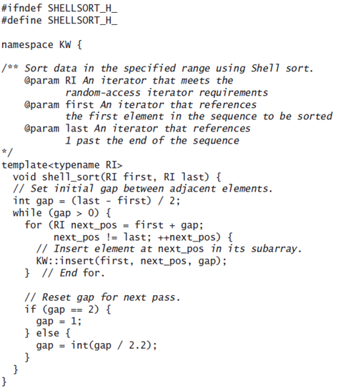
Code for Shell Sort

Slide 255
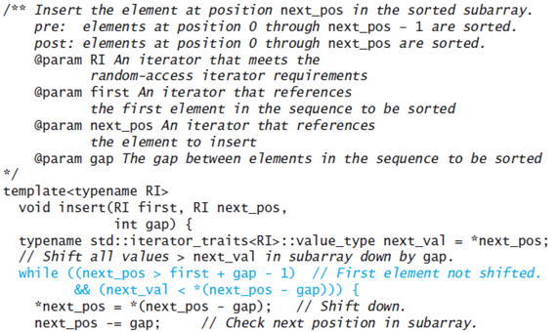
Code for Shell Sort (cont.)

Slide 256
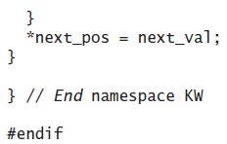
Code for Shell Sort (cont.)

Slide 257
Merge Sort
Section 10.7

Slide 258
Merge
A merge is a common data processing operation performed on two sequences of data with the following characteristics
Both sequences are ordered by the same comparison operator (that is, both sequences are sorted)
The result of the merge operation is a third sequence containing all the data from the first two sequences

Slide 259
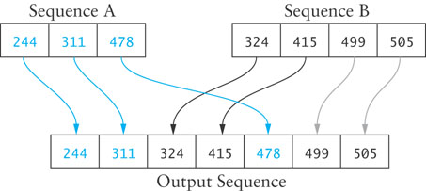
Merge Algorithm
Merge Algorithm
1. Access the first item from both sequences.
2. while not finished with either sequence
3. Compare the current items from the two sequences, copy the smaller current item to the output sequence, and access the next item from the input sequence whose item was copied.
4. Copy any remaining items from the first sequence to the output sequence.
5. Copy any remaining items from the second sequence to the output sequence.

Slide 260
Analysis of Merge
For two input sequences each containing n elements, each element needs to move from its input sequence to the output sequence
Merge time is O(n)
Space requirements
The array cannot be merged in place
Additional space usage is O(n)

Slide 261
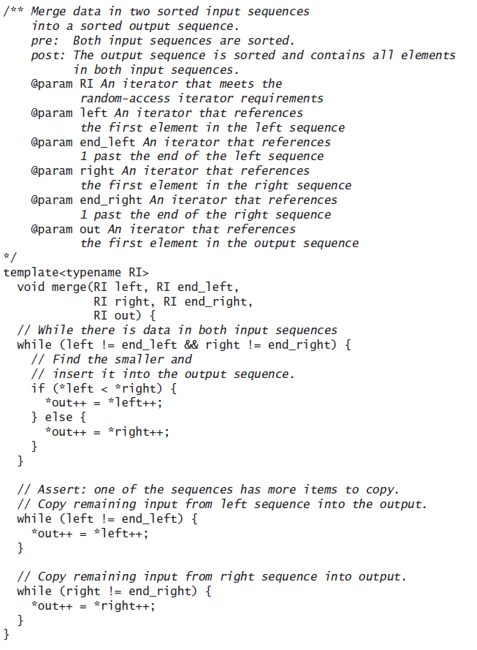
Code for Merge

Slide 262
Merge Sort
We can modify merging to sort a single, unsorted array
Split the array into two halves
Sort the left half
Sort the right half
Merge the two
This algorithm can be written with a recursive step

Slide 263
(recursive) Algorithm for Merge Sort
Algorithm for Merge Sort
if the table has more than one element
Store the first half of the table in left_table
Store the second half of the table in right_table
Recursively apply the merge sort algorithm to left_table
Recursively apply the merge sort algorithm to right_table
Call the merge function with left_table and right_table as the input sequences and the original table as the output sequence

Slide 264
Trace of Merge Sort
50
60
45
30
90
20
80
15
50
60
45
30
90
20
80
15
50
60
45
30
90
20
80
15

Slide 265
Trace of Merge Sort (cont.)
50
60
45
30
90
20
80
15
50
60
45
30
90
20
80
15
50
60
45
30
50
60
45
30

Slide 266
Trace of Merge Sort (cont.)
50
60
45
30
90
20
80
15
50
60
45
30
90
20
80
15
50
60
45
30
50
60
50
60

Slide 267
Trace of Merge Sort (cont.)
50
60
45
30
90
20
80
15
50
60
45
30
90
20
80
15
50
60
45
30
50
60
60

Slide 268
Trace of Merge Sort (cont.)
50
60
45
30
90
20
80
15
50
60
45
30
90
20
80
15
50
60
45
30
45
30
45
30

Slide 269
Trace of Merge Sort (cont.)
50
60
45
30
90
20
80
15
50
60
45
30
90
20
80
15
50
60
30
45
30
45
45
30
45

Slide 270
Trace of Merge Sort (cont.)
50
60
45
30
90
20
80
15
30
50
45
60
50
45
60
30
90
20
80
15
50
60
30
45
30
45
45
30

Slide 271
Trace of Merge Sort (cont.)
50
60
45
30
90
20
80
15
30
50
45
60
50
45
60
30
90
20
80
15
90
20
80
15

Slide 272
Trace of Merge Sort (cont.)
50
60
45
30
90
20
80
15
30
50
45
60
50
45
60
30
90
20
80
15
90
20
80
15
90
20

Slide 273
Trace of Merge Sort (cont.)
50
60
45
30
90
20
80
15
30
50
45
60
50
45
60
30
90
20
80
15
90
20
20
90
80
15
90
20

Slide 274
Trace of Merge Sort (cont.)
50
60
45
30
90
20
80
15
30
50
45
60
50
45
60
30
90
20
80
15
20
90
80
15
80
15

Slide 275
Trace of Merge Sort (cont.)
50
60
45
30
90
20
80
15
30
50
45
60
50
45
60
30
90
20
80
15
20
90
80
15
80
15
80
15

Slide 276
Trace of Merge Sort (cont.)
50
60
45
30
90
20
80
15
30
50
45
60
50
45
60
30
90
15
20
20
80
80
15
90
20
90
15
80

Slide 277
Trace of Merge Sort (cont.)
50
15
60
20
45
30
30
45
90
50
20
60
80
80
15
90
30
50
45
60
50
45
60
30
90
15
20
20
85
80
15
90

Slide 278
Analysis of Merge Sort
Each backward step requires a movement of n elements from smaller-size arrays to larger arrays; the effort is O(n)
The number of steps which require merging is log n because each recursive call splits the array in half
The total effort to reconstruct the sorted array through merging is O(n log n)

Slide 279
Analysis of Merge Sort (cont.)

Slide 280
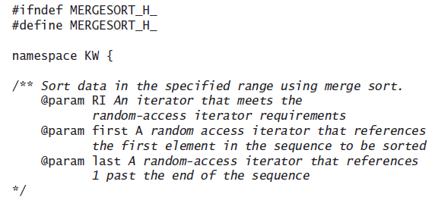
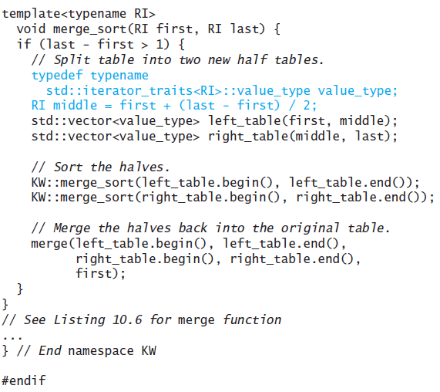
Code for Merge Sort

Slide 281
Heapsort
Section 10.8

Slide 282
Heapsort
Merge sort time is O(n log n) but still requires, temporarily, n extra storage locations
Heapsort does not require any additional storage
As its name implies, heapsort uses a heap to store the array

Slide 283
Heapsort Algorithm
A max heap is a data structure that maintains the largest value at the top
Once we have a heap, we can remove one item at a time from the heap
The item removed is always the top element, and we will place it at the bottom of the heap
When we reheap, the larger of a node’s two children is moved up the heap, so the new heap will have the next largest item as its root
As we continue to remove items from the heap, the heap size shrinks as the number of the removed items increases
If we implement the heap using an array, each element removed will be placed at the end of the array, but in front of the elements that were removed earlier
After we remove the last element, the array will be sorted

Slide 284
Trace of Heapsort
89
76
74
37
32
39
66
20
26
18
28
29
6

Slide 285
Trace of Heapsort (cont.)
89
76
74
37
32
39
66
20
26
18
28
29
6

Slide 286
Trace of Heapsort (cont.)
89
76
74
37
32
39
66
20
26
18
28
29
6

Slide 287
Trace of Heapsort (cont.)
6
76
74
37
32
39
66
20
26
18
28
29
89

Slide 288
Trace of Heapsort (cont.)
76
6
74
37
32
39
66
20
26
18
28
29
89

Slide 289
Trace of Heapsort (cont.)
76
37
74
6
32
39
66
20
26
18
28
29
89

Slide 290
Trace of Heapsort (cont.)
76
37
74
26
32
39
66
20
6
18
28
29
89

Slide 291
Trace of Heapsort (cont.)
76
37
74
26
32
39
66
20
6
18
28
29
89

Slide 292
Trace of Heapsort (cont.)
76
37
74
26
32
39
66
20
6
18
28
29
89

Slide 293
Trace of Heapsort (cont.)
76
37
74
26
32
39
66
20
6
18
28
29
89

Slide 294
Trace of Heapsort (cont.)
29
37
74
26
32
39
66
20
6
18
28
76
89

Slide 295
Trace of Heapsort (cont.)
74
37
29
26
32
39
66
20
6
18
28
76
89

Slide 296
Trace of Heapsort (cont.)
74
37
66
26
32
39
29
20
6
18
28
76
89

Slide 297
Trace of Heapsort (cont.)
74
37
66
26
32
39
29
20
6
18
28
76
89

Slide 298
Trace of Heapsort (cont.)
74
37
66
26
32
39
29
20
6
18
28
76
89

Slide 299
Trace of Heapsort (cont.)
74
37
66
26
32
39
29
20
6
18
28
76
89

Slide 300
Trace of Heapsort (cont.)
28
37
66
26
32
39
29
20
6
18
74
76
89

Slide 301
Trace of Heapsort (cont.)
66
37
28
26
32
39
29
20
6
18
74
76
89

Slide 302
Trace of Heapsort (cont.)
66
37
39
26
32
28
29
20
6
18
74
76
89

Slide 303
Trace of Heapsort (cont.)
66
37
39
26
32
28
29
20
6
18
74
76
89

Slide 304
Trace of Heapsort (cont.)
66
37
39
26
32
28
29
20
6
18
74
76
89

Slide 305
Trace of Heapsort (cont.)
66
37
39
26
32
28
29
20
6
18
74
76
89

Slide 306
Trace of Heapsort (cont.)
18
37
39
26
32
28
29
20
6
66
74
76
89

Slide 307
Trace of Heapsort (cont.)
39
37
18
26
32
28
29
20
6
66
74
76
89

Slide 308
Trace of Heapsort (cont.)
39
37
29
26
32
28
18
20
6
66
74
76
89

Slide 309
Trace of Heapsort (cont.)
39
37
29
26
32
28
18
20
6
66
74
76
89

Slide 310
Trace of Heapsort (cont.)
39
37
29
26
32
28
18
20
6
66
74
76
89

Slide 311
Trace of Heapsort (cont.)
39
37
29
26
32
28
18
20
6
66
74
76
89

Slide 312
Trace of Heapsort (cont.)
6
37
29
26
32
28
18
20
39
66
74
76
89

Slide 313
Trace of Heapsort (cont.)
37
6
29
26
32
28
18
20
39
66
74
76
89

Slide 314
Trace of Heapsort (cont.)
37
32
29
26
6
28
18
20
39
66
74
76
89

Slide 315
Trace of Heapsort (cont.)
37
32
29
26
6
28
18
20
39
66
74
76
89

Slide 316
Trace of Heapsort (cont.)
37
32
29
26
6
28
18
20
39
66
74
76
89

Slide 317
Trace of Heapsort (cont.)
37
32
29
26
6
28
18
20
39
66
74
76
89

Slide 318
Trace of Heapsort (cont.)
20
32
29
26
6
28
18
37
39
66
74
76
89

Slide 319
Trace of Heapsort (cont.)
32
20
29
26
6
28
18
37
39
66
74
76
89

Slide 320
Trace of Heapsort (cont.)
32
26
29
20
6
28
18
37
39
66
74
76
89

Slide 321
Trace of Heapsort (cont.)
32
26
29
20
6
28
18
37
39
66
74
76
89

Slide 322
Trace of Heapsort (cont.)
32
26
29
20
6
28
18
37
39
66
74
76
89

Slide 323
Trace of Heapsort (cont.)
32
26
29
20
6
28
18
37
39
66
74
76
89

Slide 324
Trace of Heapsort (cont.)
18
26
29
20
6
28
32
37
39
66
74
76
89

Slide 325
Trace of Heapsort (cont.)
29
26
18
20
6
28
32
37
39
66
74
76
89

Slide 326
Trace of Heapsort (cont.)
29
26
28
20
6
18
32
37
39
66
74
76
89

Slide 327
Trace of Heapsort (cont.)
29
26
28
20
6
18
32
37
39
66
74
76
89

Slide 328
Trace of Heapsort (cont.)
29
26
28
20
6
18
32
37
39
66
74
76
89

Slide 329
Trace of Heapsort (cont.)
29
26
28
20
6
18
32
37
39
66
74
76
89

Slide 330
Trace of Heapsort (cont.)
18
26
28
20
6
29
32
37
39
66
74
76
89

Slide 331
Trace of Heapsort (cont.)
28
26
18
20
6
29
32
37
39
66
74
76
89

Slide 332
Trace of Heapsort (cont.)
28
26
18
20
6
29
32
37
39
66
74
76
89

Slide 333
Trace of Heapsort (cont.)
28
26
18
20
6
29
32
37
39
66
74
76
89

Slide 334
Trace of Heapsort (cont.)
28
26
18
20
6
29
32
37
39
66
74
76
89

Slide 335
Trace of Heapsort (cont.)
6
26
18
20
28
29
32
37
39
66
74
76
89

Slide 336
Trace of Heapsort (cont.)
26
6
18
20
28
29
32
37
39
66
74
76
89

Slide 337
Trace of Heapsort (cont.)
26
20
18
6
28
29
32
37
39
66
74
76
89

Slide 338
Trace of Heapsort (cont.)
26
20
18
6
28
29
32
37
39
66
74
76
89

Slide 339
Trace of Heapsort (cont.)
26
20
18
6
28
29
32
37
39
66
74
76
89

Slide 340
Trace of Heapsort (cont.)
26
20
18
6
28
29
32
37
39
66
74
76
89

Slide 341
Trace of Heapsort (cont.)
6
20
18
26
28
29
32
37
39
66
74
76
89

Slide 342
Trace of Heapsort (cont.)
20
6
18
26
28
29
32
37
39
66
74
76
89

Slide 343
Trace of Heapsort (cont.)
20
6
18
26
28
29
32
37
39
66
74
76
89

Slide 344
Trace of Heapsort (cont.)
20
6
18
26
28
29
32
37
39
66
74
76
89

Slide 345
Trace of Heapsort (cont.)
20
6
18
26
28
29
32
37
39
66
74
76
89

Slide 346
Trace of Heapsort (cont.)
18
6
20
26
28
29
32
37
39
66
74
76
89

Slide 347
Trace of Heapsort (cont.)
18
6
20
26
28
29
32
37
39
66
74
76
89

Slide 348
Trace of Heapsort (cont.)
18
6
20
26
28
29
32
37
39
66
74
76
89

Slide 349
Trace of Heapsort (cont.)
18
6
20
26
28
29
32
37
39
66
74
76
89

Slide 350
Trace of Heapsort (cont.)
6
18
20
26
28
29
32
37
39
66
74
76
89

Slide 351
Trace of Heapsort (cont.)
6
18
20
26
28
29
32
37
39
66
74
76
89

Slide 352
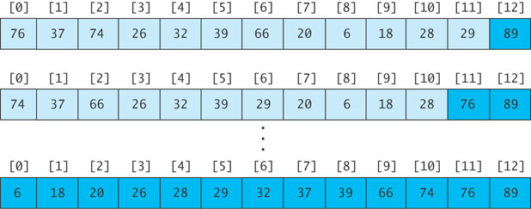
Revising the Heapsort Algorithm
If we implement the heap as an array
each element removed will be placed at the end of the array, and
the heap part of the array decreases by one element

Slide 353
Algorithm for In-Place Heapsort
Algorithm for In-Place Heapsort
1. Build a heap by rearranging the elements in an unsorted array
2. while the heap is not empty
3. Remove the first item from the heap by swapping it with the last item in the heap and restoring the heap property

Slide 354
Algorithm to Build a Heap
If we want to sort the sequence table bounded by the iterators first through last, we can consider the first item to be a heap of one item
We now consider the general case where the items in the sequence from table[first] through table[first + n - 1] form a heap; the items from table[first + n] through table[last – 1] are not in the heap
As each item is inserted, we must “reheap” to restore the heap property

Slide 355
Algorithm to Build a Heap (cont.)
Refinement of Step 1 for In-Place Heapsort
1.1 while n is less than table.length
1.2 Increment n by 1. This inserts a new item into the heap
1.3 Restore the heap property

Slide 356
Analysis of Heapsort
Because a heap of size n is a complete binary tree, it has log n levels
Building a heap requires finding the correct location for an item in a heap with log n levels
Each insert (or remove) is O(log n)
With n items, building a heap is O(n log n)
No extra storage is needed

Slide 357
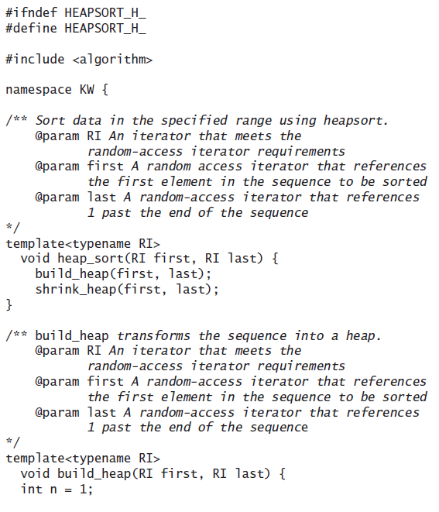
Code for Heapsort

Slide 358
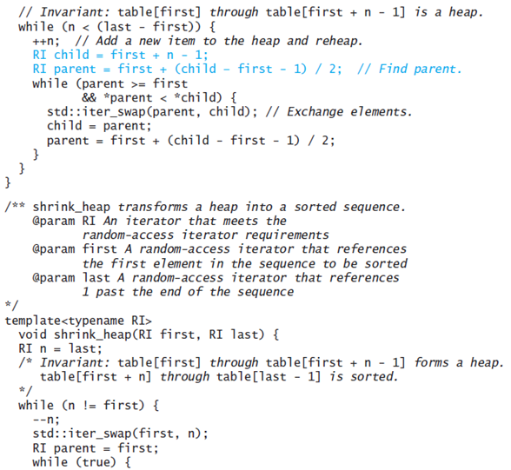
Code for Heapsort (cont.)

Slide 359
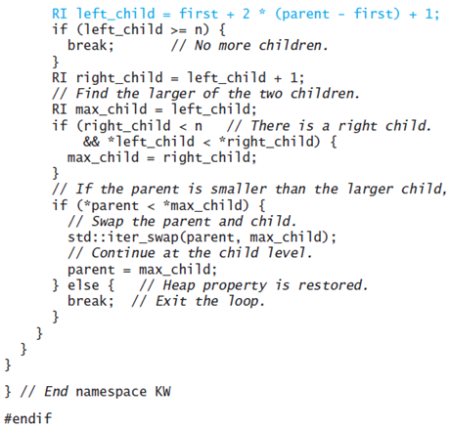
Code for Heapsort (cont.)

Slide 360
Quicksort
Section 10.9

Slide 361
Quicksort
Developed in 1962
Quicksort selects a specific value called a pivot and rearranges the array into two parts (called partitioning)
all the elements in the left subarray are less than or equal to the pivot
all the elements in the right subarray are larger than the pivot
The pivot is placed between the two subarrays
The process is repeated until the array is sorted

Slide 362
Trace of Quicksort
44
75
23
43
55
12
64
77
33

Slide 363
Trace of Quicksort (cont.)
44
75
23
43
55
12
64
77
33
Arbitrarily select the first element as the pivot

Slide 364
Trace of Quicksort (cont.)
55
75
23
43
44
12
64
77
33
Swap the pivot with the element in the middle

Slide 365
Trace of Quicksort (cont.)
55
75
23
43
44
12
64
77
33
Partition the elements so that all values less than or equal to the pivot are to the left, and all values greater than the pivot are to the right

Slide 366
Trace of Quicksort (cont.)
12
33
23
43
44
55
64
77
75
Partition the elements so that all values less than or equal to the pivot are to the left, and all values greater than the pivot are to the right

Slide 367
Quicksort Example(cont.)
44 is now in its correct position
12
33
23
43
44
55
64
77
75

Slide 368
Trace of Quicksort (cont.)
12
33
23
43
44
55
64
77
75
Now apply quicksort recursively to the two subarrays

Slide 369
Trace of Quicksort (cont.)
Pivot value = 12
12
33
23
43
44
55
64
77
75

Slide 370
Trace of Quicksort (cont.)
Pivot value = 12
12
33
23
43
44
55
64
77
75

Slide 371
Trace of Quicksort (cont.)
Pivot value = 33
12
33
23
43
44
55
64
77
75

Slide 372
Trace of Quicksort (cont.)
Pivot value = 33
12
23
33
43
44
55
64
77
75

Slide 373
Trace of Quicksort (cont.)
Pivot value = 33
12
23
33
43
44
55
64
77
75

Slide 374
Trace of Quicksort (cont.)
Pivot value = 33
12
23
33
43
44
55
64
77
75
Left and right subarrays have single values; they are sorted

Slide 375
Trace of Quicksort (cont.)
Pivot value = 33
12
23
33
43
44
55
64
77
75
Left and right subarrays have single values; they are sorted

Slide 376
Trace of Quicksort (cont.)
Pivot value = 55
12
23
33
43
44
55
64
77
75

Slide 377
Trace of Quicksort (cont.)
Pivot value = 64
12
23
33
43
44
55
64
77
75

Slide 378
Trace of Quicksort (cont.)
Pivot value = 77
12
23
33
43
44
55
64
77
75

Slide 379
Trace of Quicksort (cont.)
Pivot value = 77
12
23
33
43
44
55
64
75
77

Slide 380
Trace of Quicksort (cont.)
Pivot value = 77
12
23
33
43
44
55
64
75
77

Slide 381
Trace of Quicksort (cont.)
12
23
33
43
44
55
64
75
77
Left subarray has single value; it is sorted

Slide 382
Trace of Quicksort (cont.)
12
23
33
43
44
55
64
75
77

Slide 383
Algorithm for Quicksort
(We describe how to do the partitioning later)
The iterators first and last are the end points of the array being sorted
pivot is a pointer to the pivot value after partitioning
Algorithm for Quicksort
if the sequence has more than one element
Partition the elements in the sequence in the iterator range first through last so that the pivot value is in its correct place and is pointed to by pivot
Recursively apply quicksort to the sequence in the iterator range first through pivot
Recursively apply quicksort to the sequence in the iterator range pivot + 1 through last

Slide 384
Analysis of Quicksort
If the pivot value is a random value selected from the current sequence,
then statistically, half of the items in the subarray will be less than the pivot and half will be greater
If both subarrays have the same number of elements (best case), there will be log n levels of recursion
At each recursion level, the partitioning process involves moving an element to its correct position—n moves
Quicksort is O(n log n), just like merge sort

Slide 385
Analysis of Quicksort (cont.)

Slide 386
Analysis of Quicksort (cont.)
A quicksort will give very poor behavior if, each time the array is partitioned, a subarray is empty
In that case, the sort will be O(n²)
Under these circumstances, the overhead of recursive calls and the extra run-time stack storage required by these calls makes this version of quicksort a poor performer relative to the quadratic sorts
We’ll discuss a solution later

Slide 387
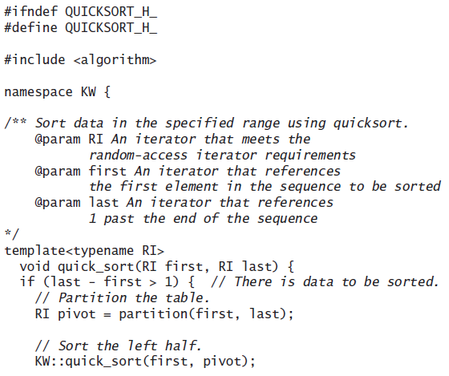
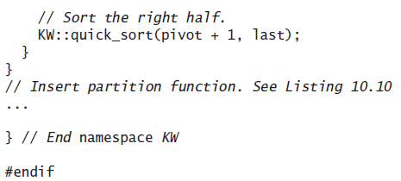
Code for Quicksort

Slide 388
Algorithm for Partitioning
44
75
23
43
55
12
64
77
33
If the array is randomly ordered, it does not matter which element is the pivot.
For simplicity we pick the element with subscript first

Slide 389
Trace of Partitioning (cont.)
44
75
23
43
55
12
64
77
33
If the array is randomly ordered, it does not matter which element is the pivot.
For simplicity we pick the element with subscript first

Slide 390
Trace of Partitioning (cont.)
44
75
23
43
55
12
64
77
33
For visualization purposes, items less than or equal to the pivot will be colored blue; items greater than the pivot will be colored light purple

Slide 391
Trace of Partitioning (cont.)
44
75
23
43
55
12
64
77
33
For visualization purposes, items less than or equal to the pivot will be colored blue; items greater than the pivot will be colored light purple

Slide 392
Trace of Partitioning (cont.)
44
75
23
43
55
12
64
77
33
Search for the first value at the left end of the array that is greater than the pivot value

Slide 393
Trace of Partitioning (cont.)
up
44
75
23
43
55
12
64
77
33
Search for the first value at the left end of the array that is greater than the pivot value

Slide 394
Trace of Partitioning (cont.)
up
44
75
23
43
55
12
64
77
33
Then search for the first value at the right end of the array that is less than or equal to the pivot value

Slide 395
Trace of Partitioning (cont.)
up
down
44
75
23
43
55
12
64
77
33
Then search for the first value at the right end of the array that is less than or equal to the pivot value

Slide 396
Trace of Partitioning (cont.)
up
down
44
75
23
43
55
12
64
77
33
Exchange these values

Slide 397
Trace of Partitioning (cont.)
44
33
23
43
55
12
64
77
75
Exchange these values

Slide 398
Trace of Partitioning (cont.)
44
33
23
43
55
12
64
77
75
Repeat

Slide 399
Trace of Partitioning (cont.)
up
44
33
23
43
55
12
64
77
75
Find first value at left end greater than pivot

Slide 400
Trace of Partitioning (cont.)
up
down
44
33
23
43
55
12
64
77
75
Find first value at right end less than or equal to pivot

Slide 401
Trace of Partitioning (cont.)
44
33
23
43
12
55
64
77
75
Exchange

Slide 402
Trace of Partitioning (cont.)
44
33
23
43
12
55
64
77
75
Repeat

Slide 403
Trace of Partitioning (cont.)
up
44
33
23
43
12
55
64
77
75
Find first element at left end greater than pivot

Slide 404
Trace of Partitioning (cont.)
down
up
44
33
23
43
12
55
64
77
75
Find first element at right end less than or equal to pivot

Slide 405
Trace of Partitioning (cont.)
down
up
44
33
23
43
12
55
64
77
75
Since down has "passed" up, do not exchange

Slide 406
Trace of Partitioning (cont.)
down
up
44
33
23
43
12
55
64
77
75
Exchange the pivot value with the value at down

Slide 407
Trace of Partitioning (cont.)
down
12
33
23
43
44
55
64
77
75
Exchange the pivot value with the value at down

Slide 408
Trace of Partitioning (cont.)
down
12
33
23
43
44
55
64
77
75
The pivot value is in the correct position; return the value of down and assign it to the iterator pivot

Slide 409
Algorithm for partition Function
Algorithm for partition Function
1. Define the pivot value as the contents of table[first].
2. Initialize up to first + 1 and down to last - 1.
3. do
4. Increment up until up selects the first element greater than the pivot value or up has reached last - 1.
5. Decrement down until down selects the first element less than or equal to the pivot value or down has reached first.
6. if up < down then
7. Exchange table[up] and table[down].
8. while up is to the left of down
9. Exchange table[first] and table[down].
10. Return the value of down to pivot.

Slide 410
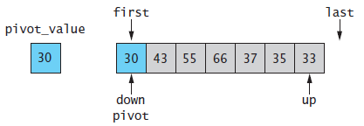
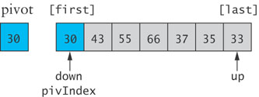
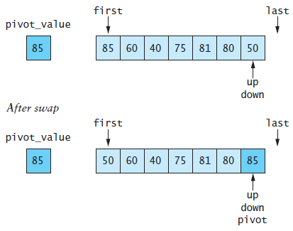
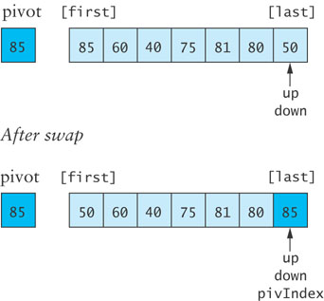
Algorithm for partition Function (cont.)

Slide 411
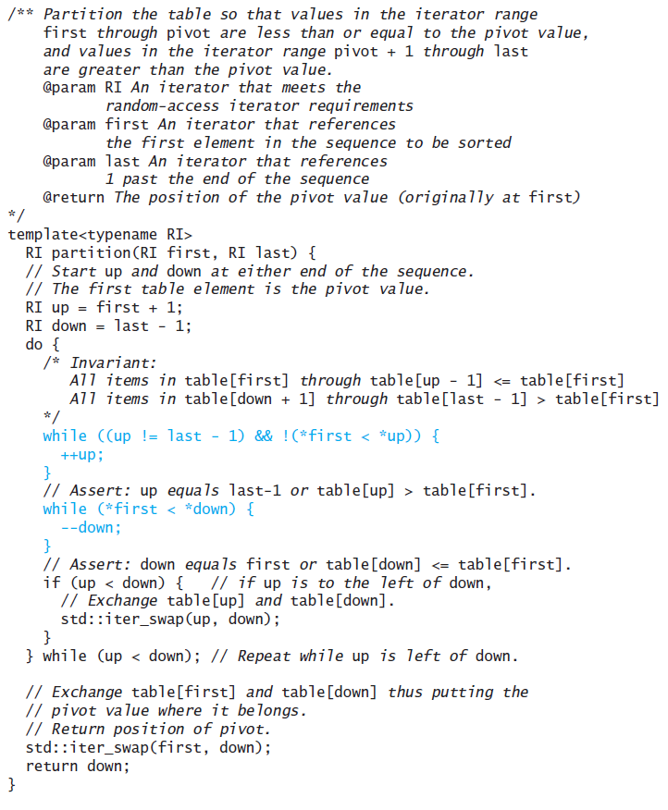
Code for partition

Slide 412
A Revised Partition Algorithm
Quicksort is O(n²) when each split yields one empty subarray, which is the case when the array is presorted
The worst possible performance occurs for a sorted array, which is not very desirable
A better solution is to pick the pivot value in a way that is less likely to lead to a bad split
Use three references: first, middle, last
Select the median of the these items as the pivot

Slide 413
A Revised Partition Algorithm (cont.)

Slide 414
Trace of Revised Partitioning
44
75
23
43
55
12
64
77
33

Slide 415
Trace of Revised Partitioning (cont.)
first
middle
last
44
75
23
43
55
12
64
77
33

Slide 416
Trace of Revised Partitioning (cont.)
first
middle
last
44
75
23
43
55
12
64
77
33
Sort these values

Slide 417
Trace of Revised Partitioning (cont.)
first
middle
last
33
75
23
43
44
12
64
77
55
Sort these values

Slide 418
Trace of Revised Partitioning (cont.)
first
middle
last
33
75
23
43
44
12
64
77
55
Exchange middle with first

Slide 419
Trace of Revised Partitioning (cont.)
first
middle
last
44
75
23
43
33
12
64
77
55
Exchange middle with first

Slide 420
Trace of Revised Partitioning (cont.)
44
75
23
43
33
12
64
77
55
Run the partition algorithm using the first element as the pivot

Slide 421
Algorithm for Revised partition Function
Algorithm for Revised partition Function
Sort table[first], table[middle], and table[last – 1]
Move the median value to the first position (the pivot value) by exchanging table[first] and table[middle]
Initialize up to first + 1 and down to last - 1
do
Increment up until up selects the first element greater than the pivot value or up has reached last - 1
Decrement down until down selects the first element less than or equal to the pivot value or down has reached first
if up < down then
Exchange table[up] and table[down]
while up is to the left of down
Exchange table[first] and table[down]
Return the value of down to pivot

Slide 422
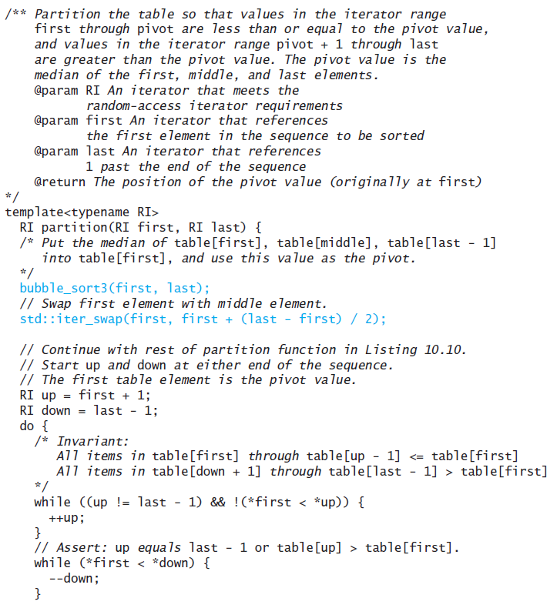
Code for Revised partition Function

Slide 423
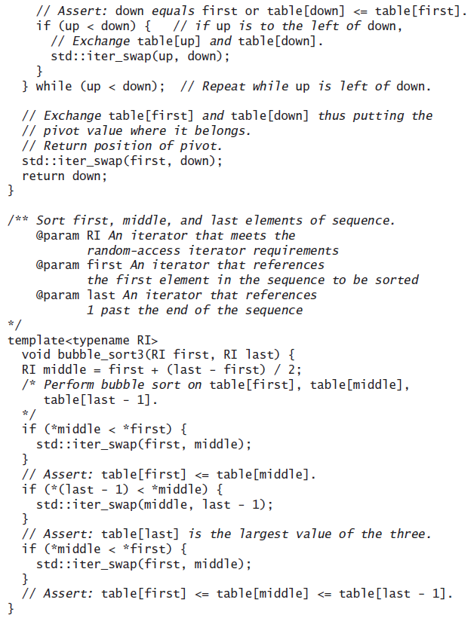
Code for Revised partition Function

Slide 424
Testing the Sort Algorithms
Section 10.10

Slide 425
Testing the Sort Algorithms
We want to get some idea of the sorting algorithms’ relative performance when sorting the same container (array, vector, or deque)
Use a variety of test cases
small and large containers
containers with elements in random order
containers that are sorted already
containers with duplicate values

Slide 426
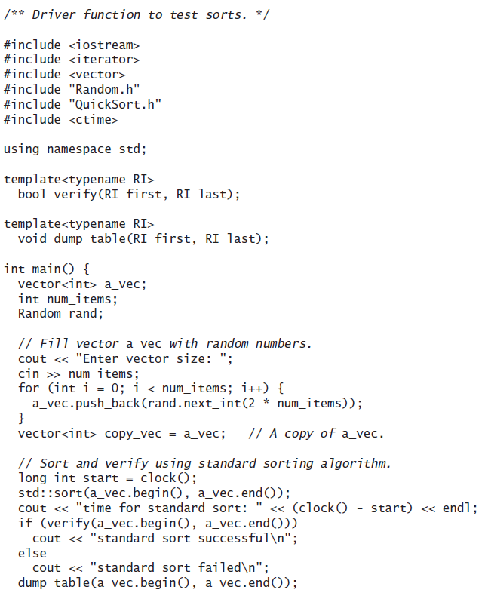
Driver to Test Sort Algorithms

Slide 427
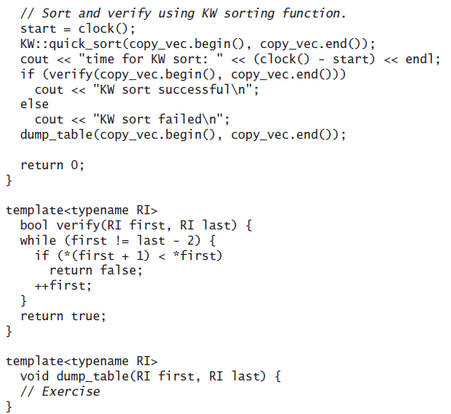
Driver to Test Sort Algorithms

Slide 428
The Dutch National Flag Problem (optional)
Section 10.11

Slide 429
The Dutch National Flag Problem
A variety of partitioning algorithms for quicksort have been published
A popular variation uses a single left-to-right scan of the array
Edsger W. Dijkstra developed a partitioning algorithm using both techniques to partition an array into three segments

Slide 430
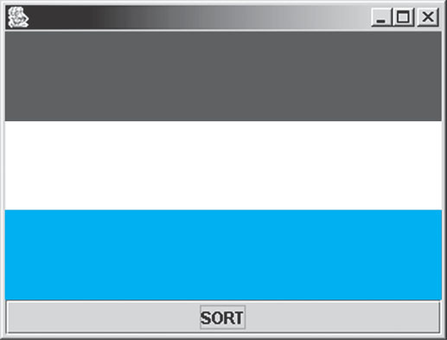
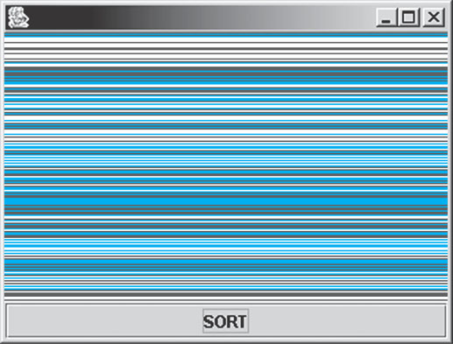
Problem
Partition a disordered three-color flag into the appropriate three segments by writing software for an unscrambling machine

Slide 431
Analysis
The unscrambling machine can
look at one thread in the flag and determine its color
swap the position of two threads in the flag
execute while loops and if statements

Slide 432
Design – Loop Invariant
As with quicksort, values between first and up are less than or equal to the pivot
Values between down and last are greater than the pivot
Values between up and down are unknown
Initially,
The unknown region is the entire array (first == up and down == last)

Slide 433
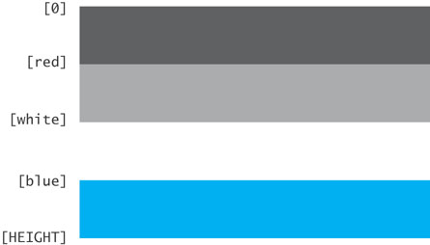
Design
Have four regions:
Red (light gray)
white
blue
unknown (dark gray)
Flag is complete:
if 0 <= i < red then threads[i] is red
if white < i <= blue then threads[i] is white
if blue < i < HEIGHT then threads[i] is blue
If red <= i <= white then the flag is not complete and the color is unknown

Slide 434
Design (cont.)
Thus we can define the following loop invariant:
if 0 <= i < red then threads[i] is red
If red <= i <= white then the color is unknown
if white < i <= blue then threads[i] is white
if blue < i < HEIGHT then threads[i] is blue

Slide 435
Algorithm

Slide 436
Preserving the Loop Invariant
Assume we know the color of threads[white] (the thread at position white)
either leave it where it is (in the white region if it is white) or
place it in the region where it belongs

Slide 437
Preserving the Loop Invariant
Three cases
The color of threads[white] is white
Decrement the value of white, increasing the size of the white region by one thread
The color of threads[white] is red
The color of threads[red] is unknown
Swap the thread at threads[red] with the thread at threads[white], adding the thread to the end of the red region and reducing the size of the unknown region by one thread
The color of threads[white] is blue
The color of threads[blue] is white
Swap the thread at threads[white] with the thread at threads[blue]
Decrement both blue and white, inserting the thread at the beginning of the blue region and reducing the size of the unknown region by one thread

Slide 438
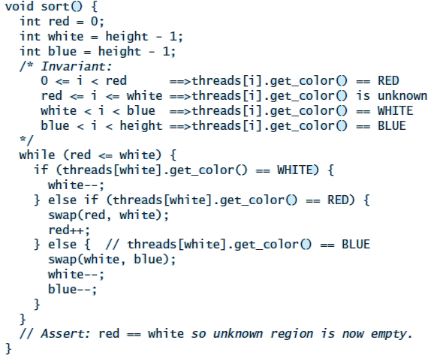
Implementation

Slide 439
Comparison of Sort Algorithms
Summary

Slide 440
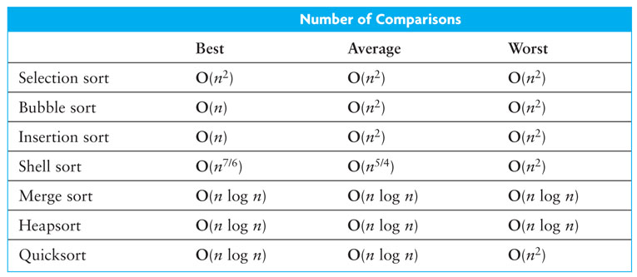
Sort Review

